Slide 1


OT Bioelettronica
Devices 2021-2024
mail@otbioelettronica.it

Slide 2

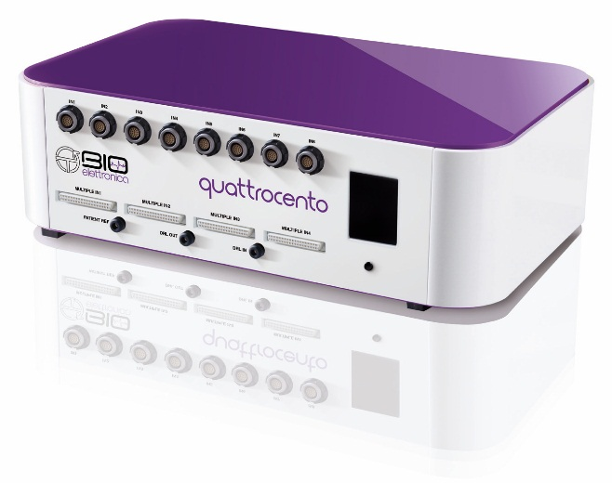
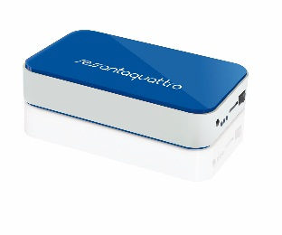
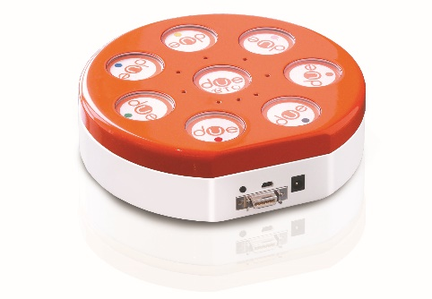
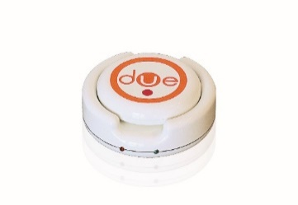
INDEX – Devices 2016-2020
Quattrocento
Sessantaquattro
DuePro
DueLite

Slide 3
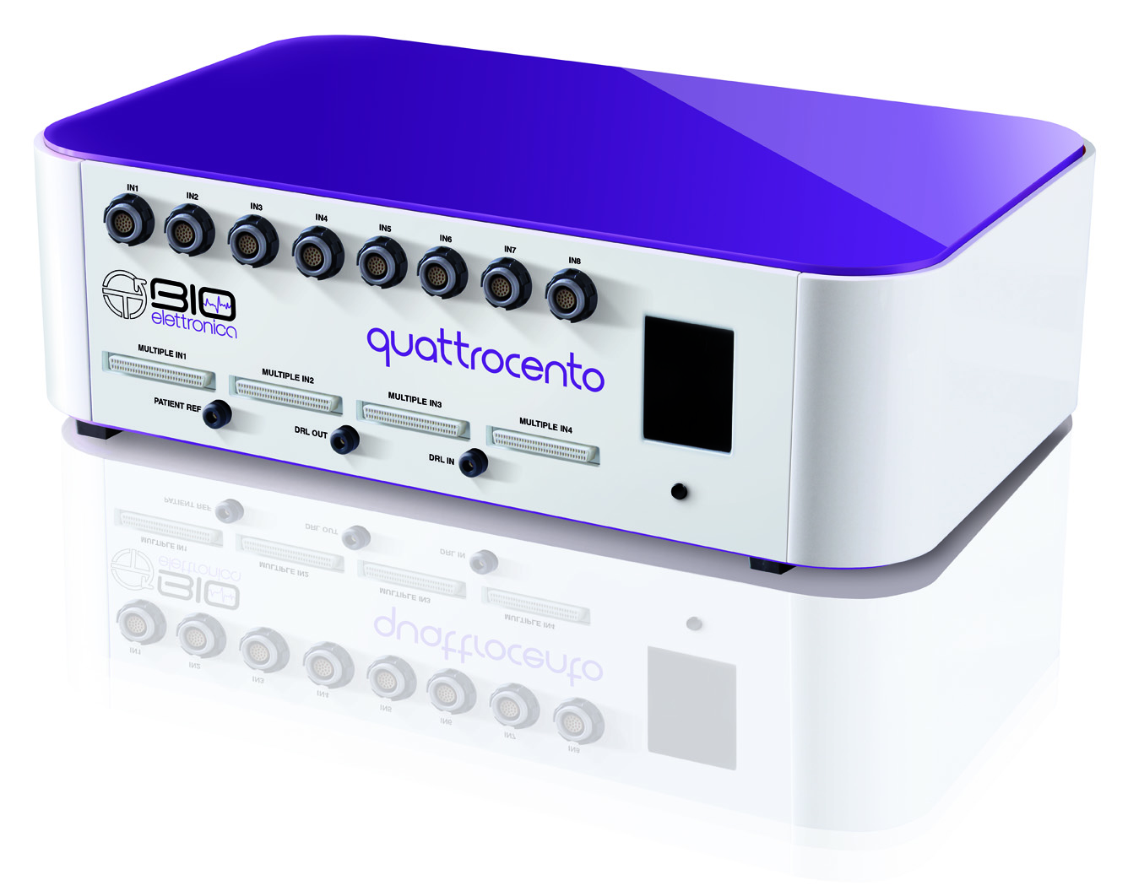
Quattrocento

Slide 4
Quattrocento
Signals: sEMG, iEMG, EEG and ECG
Available versions: 96ch –192ch – 288ch - 384ch
Auxiliary Inputs: 16 in each versions
SW: OTBioLab+
Sampling frequency: 512Hz, 2048Hz, 4400Hz
Acquisition modality: Monopolar and Differential
Input connectors: eight with 16ch from IN1 to IN8, four with 64ch each one from Multiple IN1 to Multiple IN4 (expandable to six with SP-Box-QR)
Power Supply: total floating, partially floating, with power

Slide 5
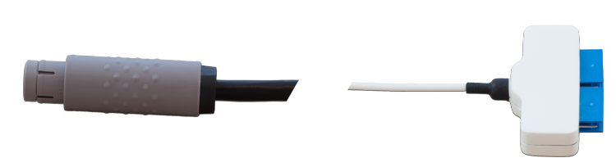
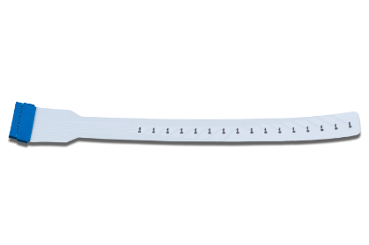
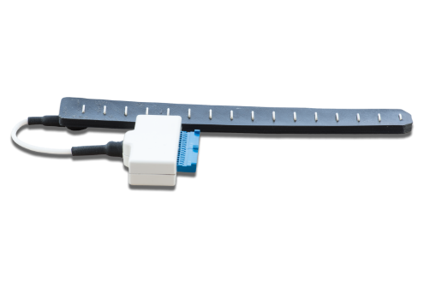
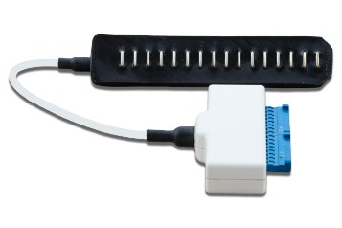
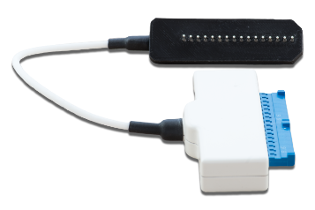
AD1x16
Electrodes:
16 channels adapter
Electrodes:
ELSCH016
SA16/10
SA16/5
SA16/2.5
Recording Modalities:
Differential (D)

Slide 6
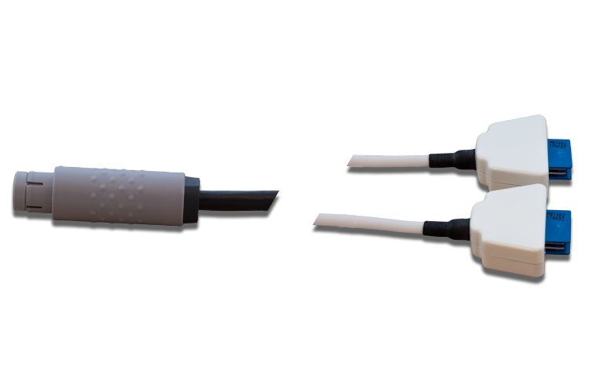
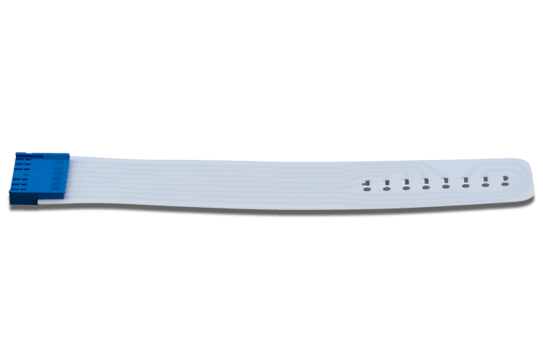
AD2x8
8 channels dual adapter
Electrodes:
Electrodes:
ELSCH008
Recording Modalities:
Differential (D)

Slide 7
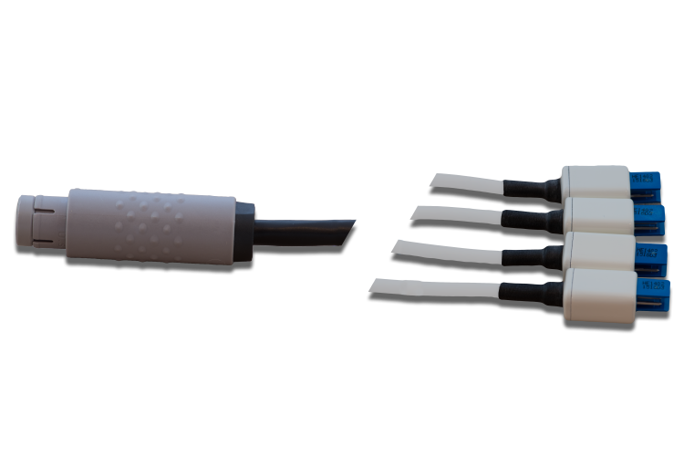
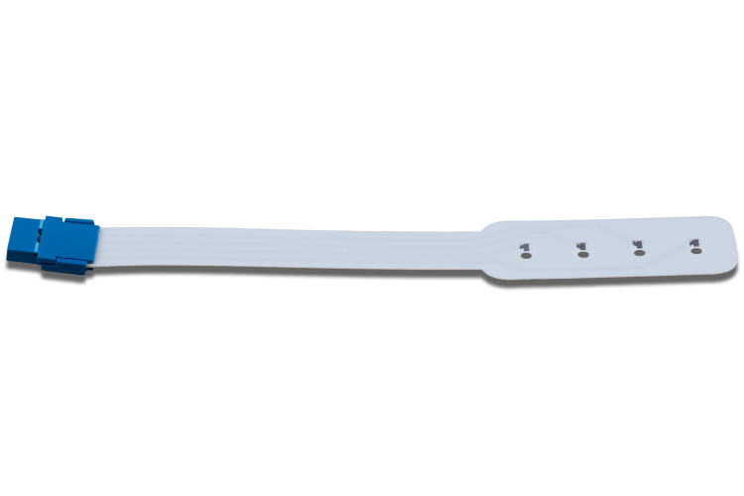
AD4x4
Electrodes:
4 channels quadruple adapter
Electrodes:
ELSCH004
Recording Modalities:
Differential (D)

Slide 8
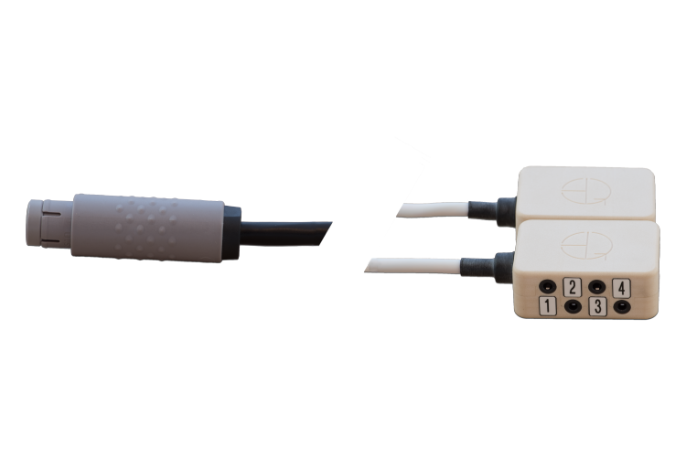
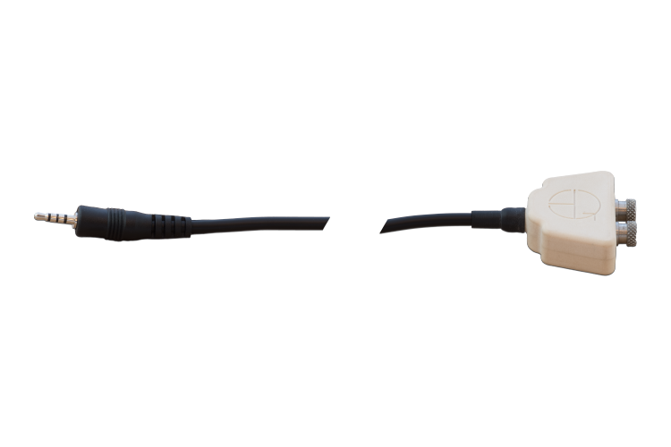
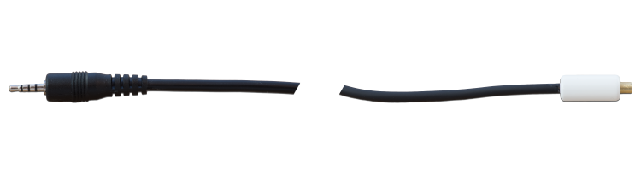
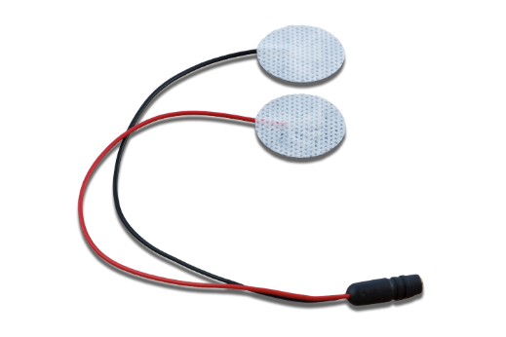
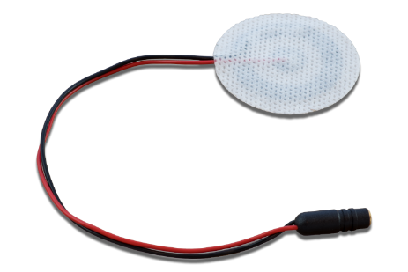
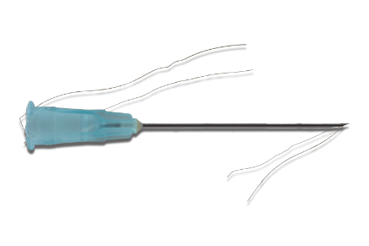
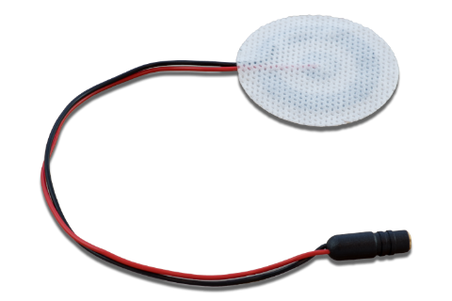
AD8x2JD
16 channels passive adapter
Active termination:
Active terminations:
ADx5
ADx5JN for iEMG
Electrodes with concentric connector:
CDE-C
CoDe1.0-C
CoDe2.0-C
Fi-Wi
Recording Modalities:
Bipolar
Electrodes:

Slide 9
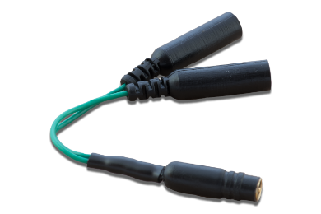
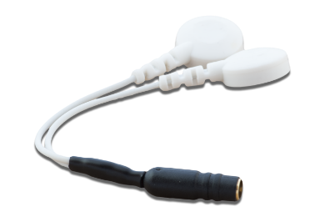
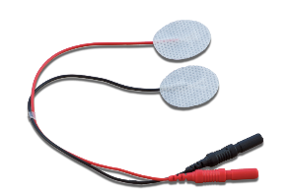
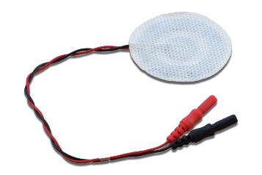
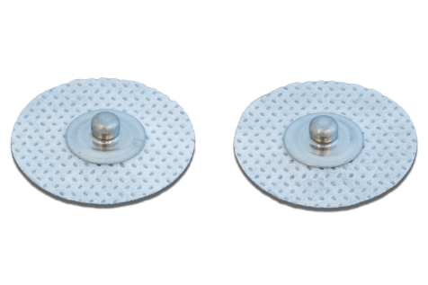

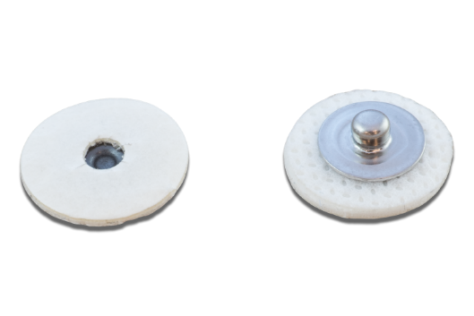
ADx5
Adapters to active termination:
C-2B
C-2S
Electrodes:
CDE-B and -S
CoDe1.0-B
CoDe2.0-B
DE1
Recording Modalities:
Bipolar
Electrodes:

Slide 10
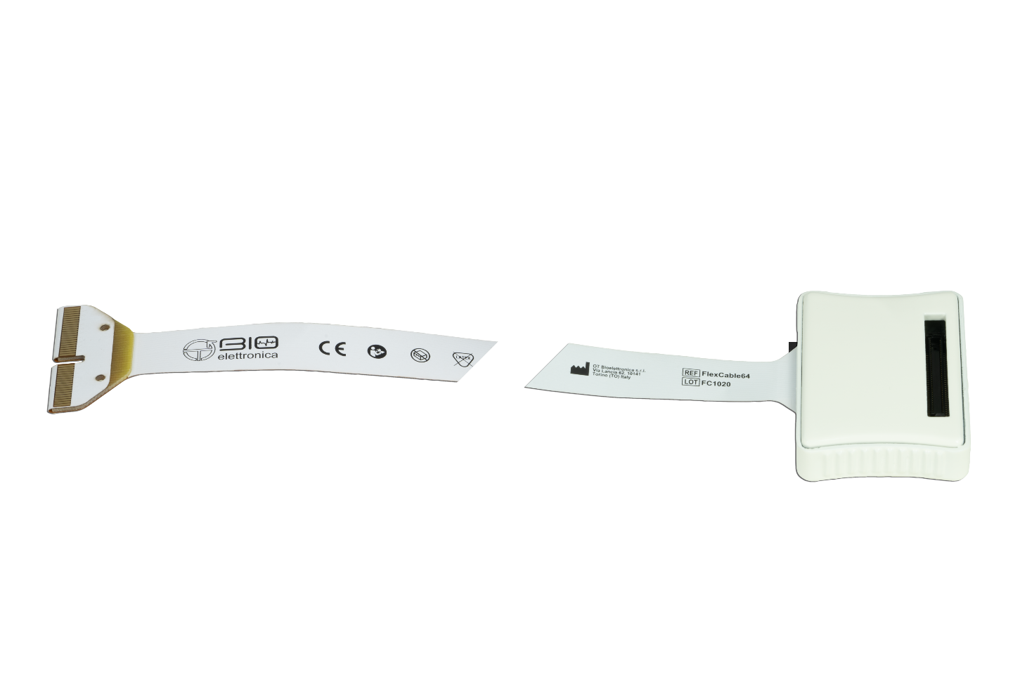
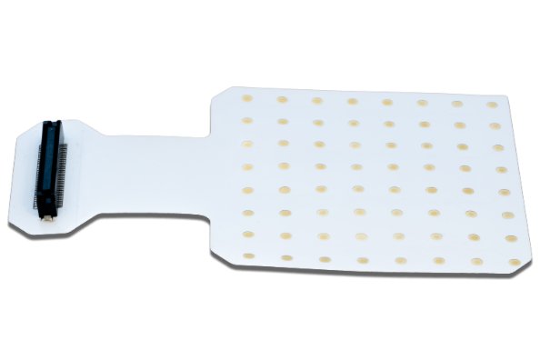
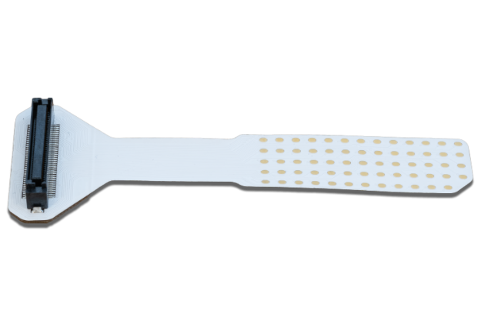
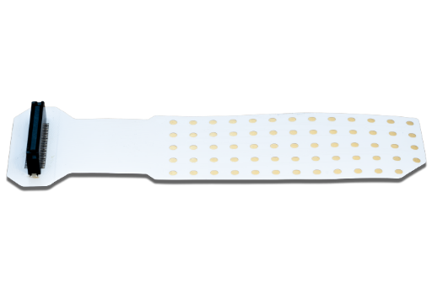
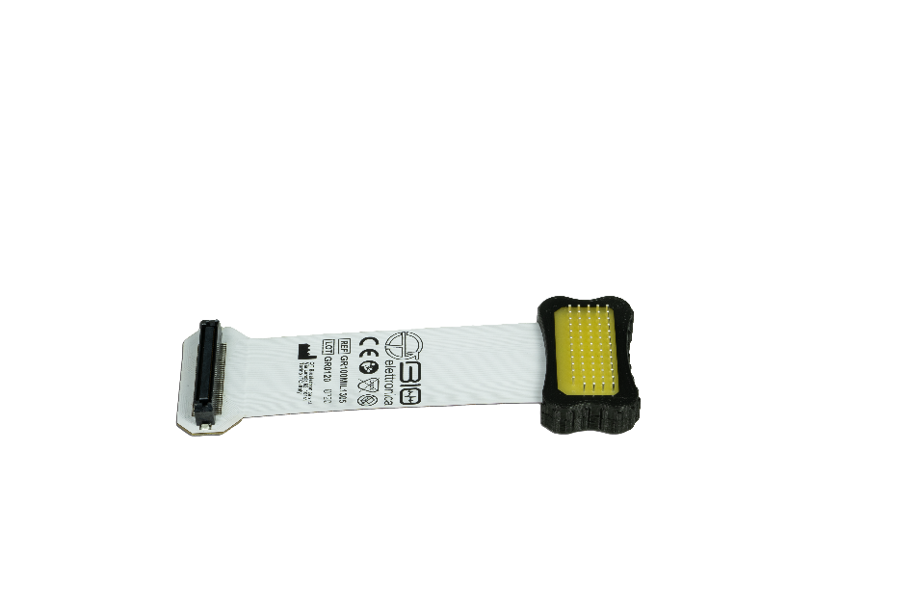
AD64F
64 channels adapter
Electrodes:
GR10MM0808
GR04MM1305
GR08MM1305
GR100ML1305
Recording Modalities:
Monopolar (M)

Slide 11
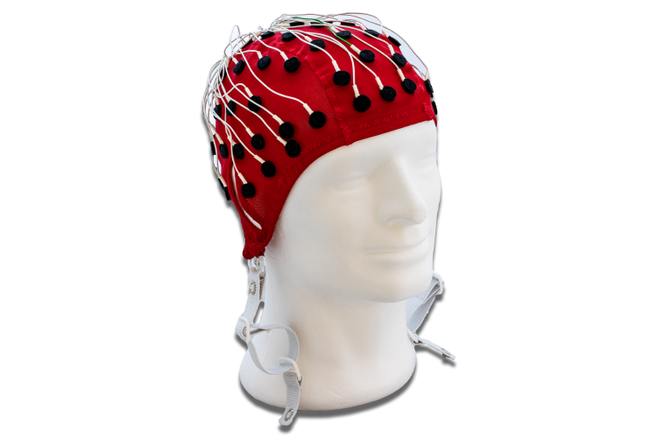
EEG-Cap
Cap for Electroencephalography:
with 20 channels
with 64 channels

Slide 12
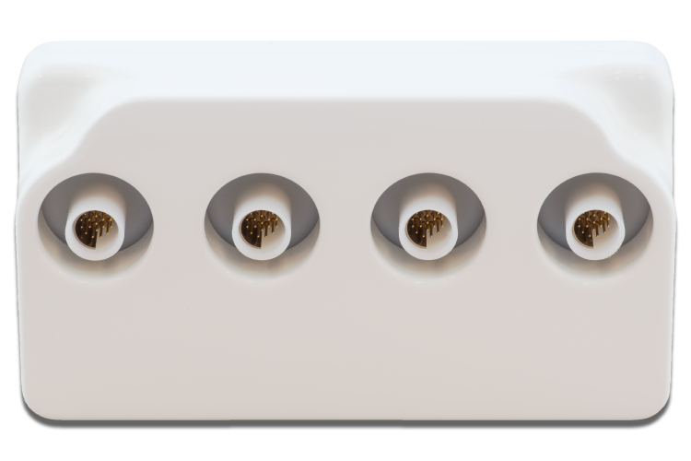
SP-BOX-QR
4 Fischer to 1 ZIF

Slide 13
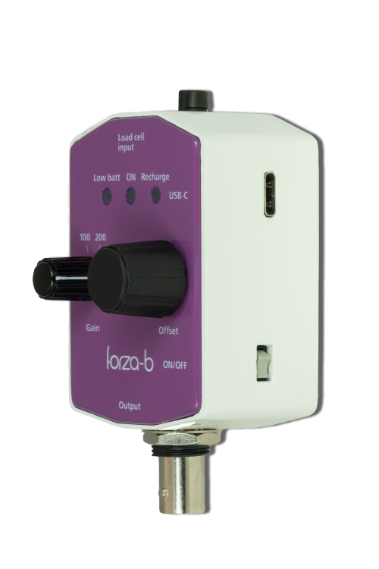
Forza-b
Load cell input
LEDs indicators
USB Connector
Gain
Offset Null
Switch
BNC Output Connector
Load Cell Input: This input allows the connection of load cells.
ON/OFF switch: With this switch is possible to turn off and on the forza-bj accessory.
Offset Null: this wheel allows you to reset the output offset of forza-bj.
Gain Select: this wheel allows you to change the system gains (100, 200, 500 or 1000 V/V).
Output: At this connector (BNC in case of forza-b or Jack 3,5 mm in case of forza-j) is available the analog force signal amplified, filtered and with the possibility to delete offset (everything is after the optical isolation of the accessory).
USB connector: this connector is used to recharge battery.

Slide 14
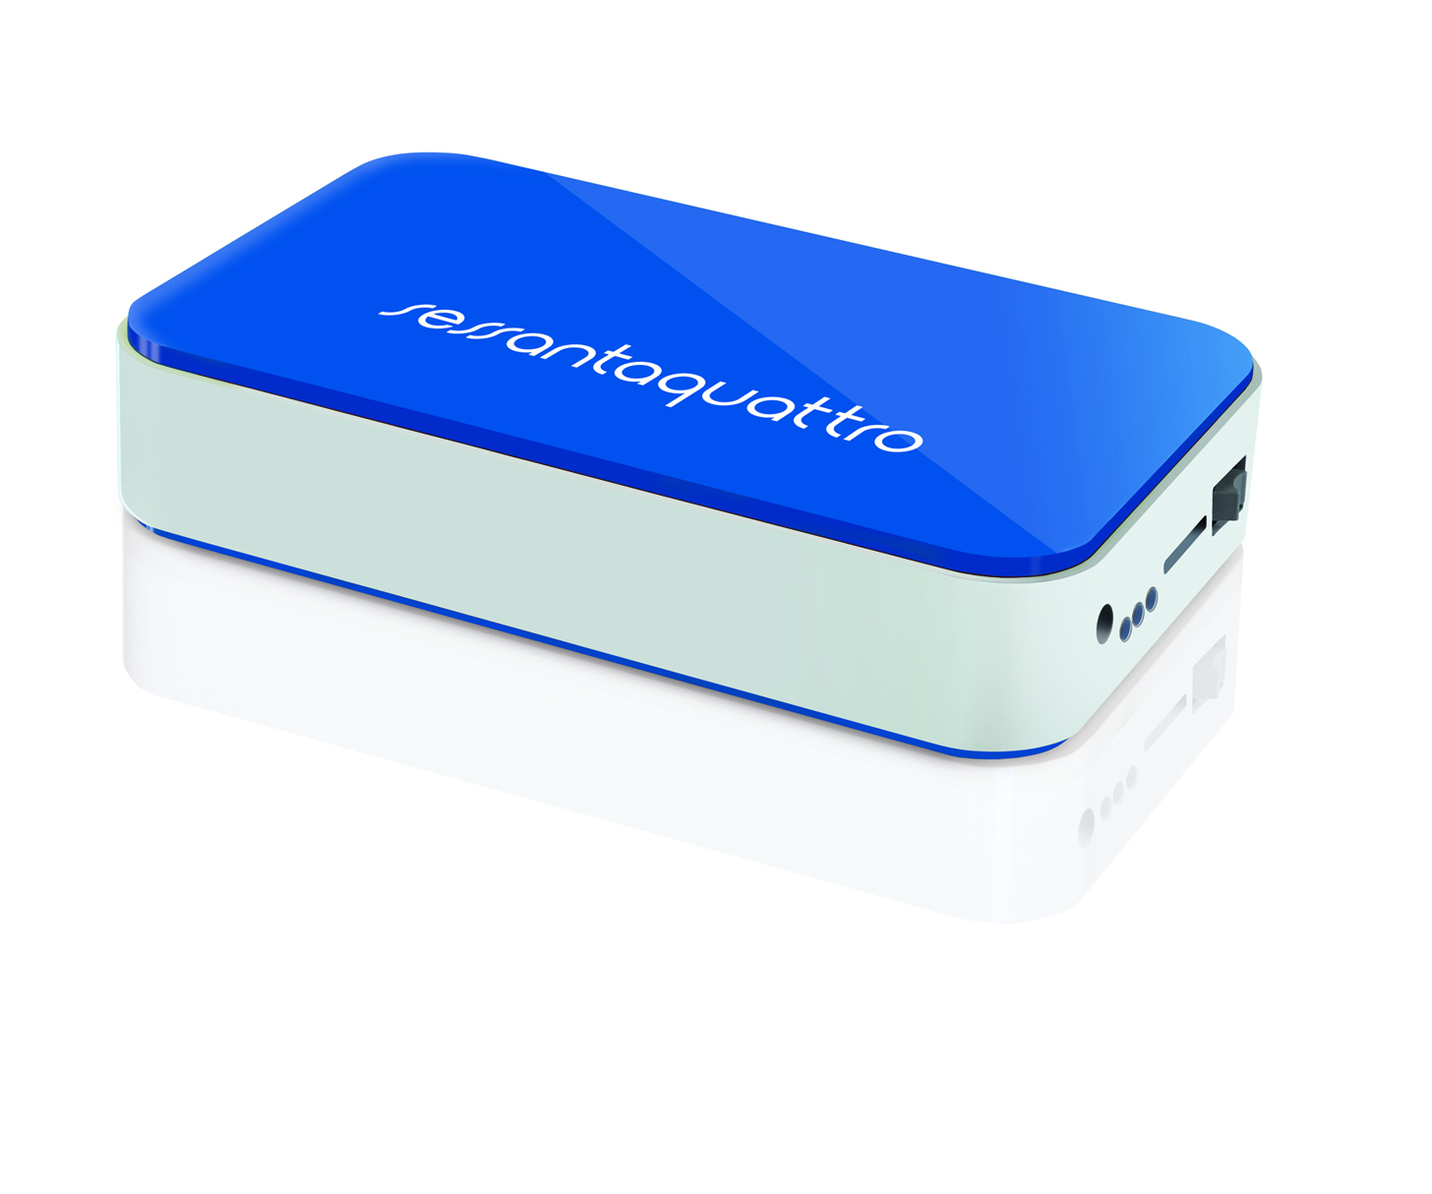
Sessantaquattro

Slide 15
Sessantaquattro
Signals: sEMG 64ch
Communication: Wi-Fi or Logger on a microSD card
Weight: 110gr
Battery duration: 8h (worst case in Wi-Fi modality)
Auxiliary Inputs: 2 in each versions
SW: OTBioLab+
Modalities:
- sEMG: SF 2048Hz, 16bit A/D conv, bandwidth 10Hz-512Hz
- Full DC: SF 512Hz, 24bit A/D conv, LPF 128Hz

Slide 16
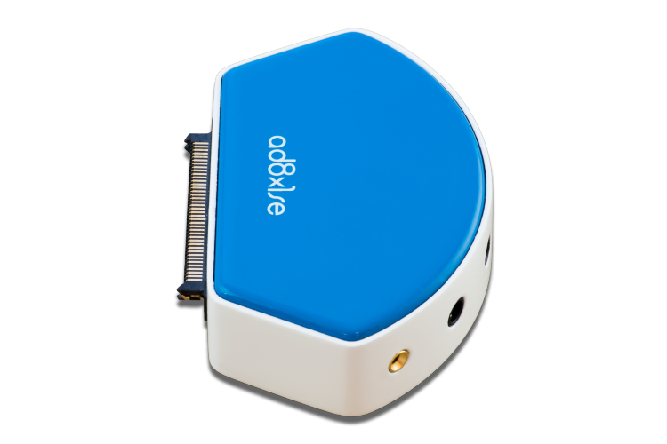
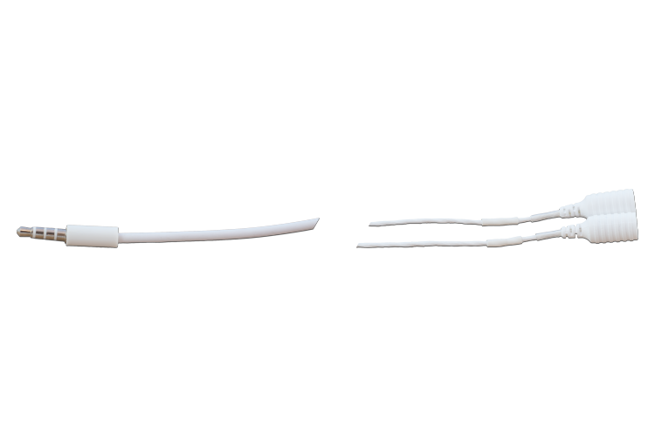
AD8x1SE
8 channel bipolar adapter
Termination:
ADx2SE
Electrodes:
CoDe 1.0-C
CoDe2.0-C
CDE-C
Recording Modalities:
Bipolar
Note:
Max 8 bipolar detection
With 2 auxiliary channels (AUX-IN)
Termination:
Electrodes:

Slide 17
ADx2SE
Adapters:
C-2B
C-2S
Electrodes:
Electrodes:
CDE-B and -S
CoDe1.0-B
CoDe2.0-B
DE1
Recording Modalities:
Bipolar

Slide 18
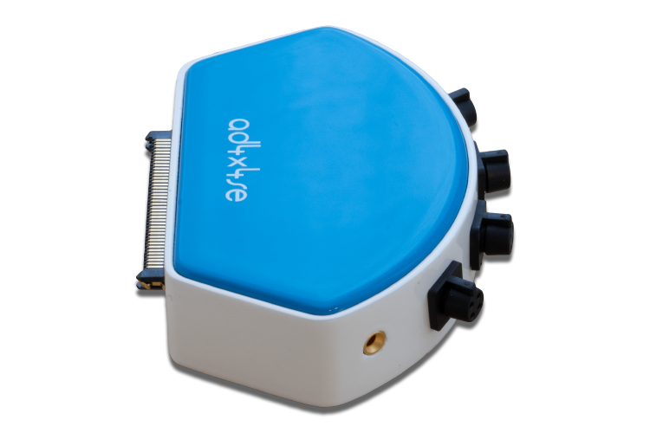
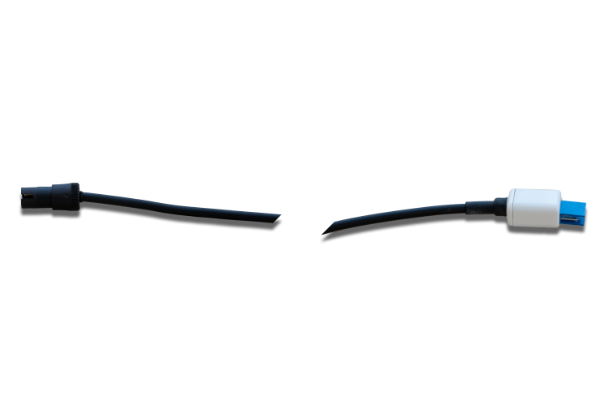
AD4x4SE
4 channel adapter for linear arrays
Termination:
Termination:
ADx4SE
Electrodes:
ELSCH004
Recording Modalities:
Bipolar
Auxiliary channels:
2 AUX-IN
Electrodes:

Slide 19
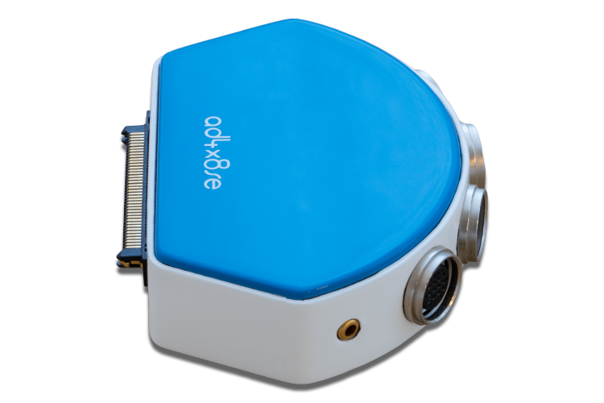
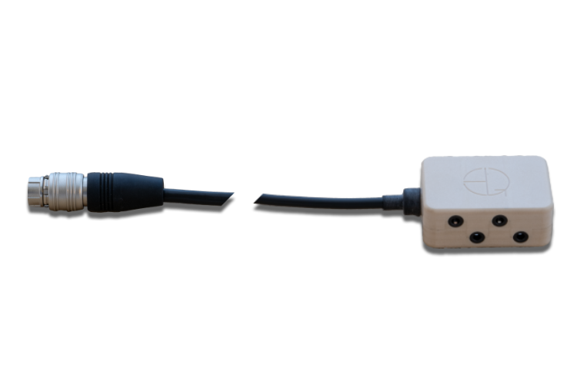

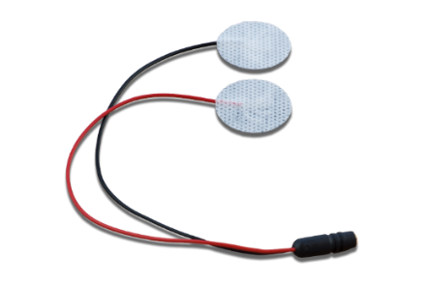
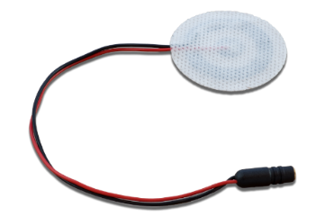
AD4x8SE
32 channel bipolar adapter
Termination:
ADx8SE
Adapters to termination:
- ADx5
Electrodes:
CoDe 1.0-C
CoDe2.0-C
CDE-C
Recording Modalities:
Bipolar
Note:
Max 32 bipolar detection
With 2 auxiliary channels (AUX-IN)
Termination:
Adapter:
Electrodes:

Slide 20
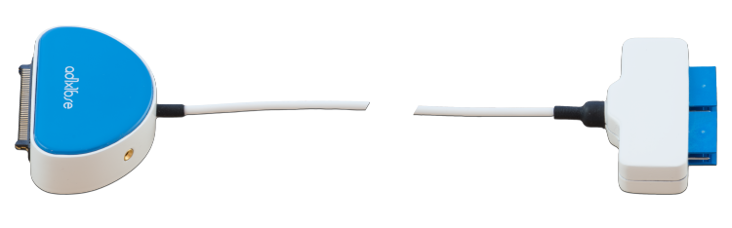
AD1x16SE
Electrodes:
16 channels adapter
Electrodes:
ELSCH016
SA16/10
SA16/5
SA16/2.5
Recording Modalities:
Monopolar (M)
Auxiliary channels:
2 AUX-IN

Slide 21
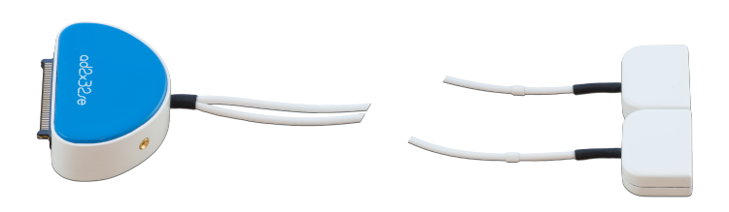
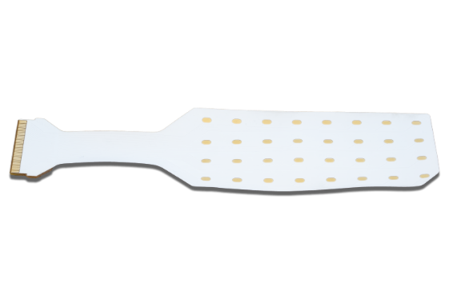
AD2x32SE
Dual 32 channels adapter
Electrodes:
Electrodes:
2 x GR10MM0804
Recording Modalities:
Monopolar
Auxiliary channels:
2 AUX-IN

Slide 22
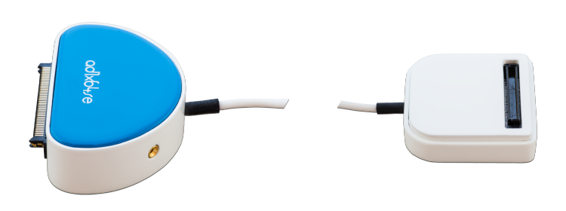
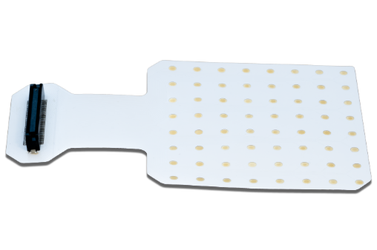
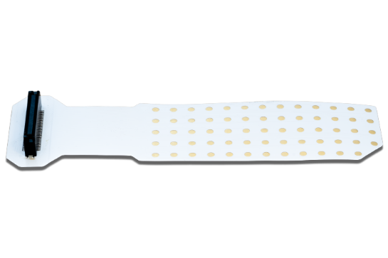


AD1x64SE
64 channels adapter
Electrodes:
Electrodes:
GR10MM0808
GR08MM1304
GR04MM1305
GR100ML1305
Recording Modalities:
Monopolar
Auxiliary channels:
2 AUX-IN

Slide 23


EEG-CapSE
Cap for Electroencephalography:
with 20 channels
with 64 channels
Note:
Direct connection between Cap
and AD64EEGSE adapter without cable

Slide 24

ISO-AUXSE
AUX-IN 1
Jack Output Connector
AUX-IN 2
Insulator for 2 AUX-IN
2 BNC inputs (range +5/-5V)
Jack ouput connector to Sessantaquattro AUX-IN

Slide 25

SyncSE
Synchronization system with radio communication and BNC output
Push button synchronization
TTL signal syncronization

Slide 26
How to use sync-se (rev5)
LED
JACK connector to sessantaquattro AUX1 and AUX2
Transmission and encription delay
Δ = 33.2 ± 0.1 ms
Jack-Jack cable to sessantaquattro adapter
LED
SWITCH
5V
0V
DIGITAL OUTPUT
USB cable to provide power
5V
To USB wall adapter or PC
0V
DIGITAL INPUT
DIGITAL INPUT
t
AUX1
Δ
t
RELEASED
SWITCH
DEPRESSED
t
DIGITAL
OUTPUT
t
AUX2
Δ
t

Slide 27

Forza-j
Load cell input
LEDs indicators
USB Connector
Gain
Offset Null
Switch
Jack Output Connector
Load Cell Input: This input allows the connection of load cells.
ON/OFF switch: With this switch is possible to turn off and on the forza-bj accessory.
Offset Null: this wheel allows you to reset the output offset of forza-bj.
Gain Select: this wheel allows you to change the system gains (100, 200, 500 or 1000 V/V).
Output: At this connector (BNC in case of forza-b or Jack 3,5 mm in case of forza-j) is available the analog force signal amplified, filtered and with the possibility to delete offset (everything is after the optical isolation of the accessory).
USB connector: this connector is used to recharge battery.

Slide 28

DuePro

Slide 29
DuePro
Signals: up to 14sEMG + 2 biomechanical (max 14 simultaneously)
EMG Probes: 2ch each one
Biomechanical probes: 2ch (amplified/not amplified/IMU)
Communication: Bluetooth
Battery duration: 12h
Wireless recharge
SW: OTBioLab+, Android App, BluePlot
Analog outputs available on the recharge station (DueStation)
HW and SW synchronization

Slide 30

DuePro: Due probe

Slide 31

DuePro: DueStrap

Slide 32




DuePro: Adapters and Electrodes
Adapters:
Electrodes:

Slide 33

DuePro: DueBio probe
2 biomechanics or kinematics channels could be connected as shown below:
CH1 | CH2
Amplified | Not amplified
Amplified | Amplified
Not amplified | Not amplified
Amplied | IMU
Not amplified | IMU

Slide 34


DueLite

Slide 35
DueLite
Signals: 2 sEMG
EMG Probe: 2 channels
Communication: Bluetooth
Battery duration: 12h
Wireless recharge
SW: OTBioLab+, Android App, BluePlot
Upgradable up to 7 Due Probes

Slide 36



INDEX – Devices 2022
Quattrocento
Sessantaquattro+
Muovi+Pro
MuoviPro

Slide 37

Sessantaquattro +

Slide 38
Sessantaquattro+
Signals: sEMG 64ch
Communication: Wi-Fi or Logger on a microSD card
Weight: 110gr
Battery duration: 10h (worst case in Wi-Fi modality)
Auxiliary Inputs: 2 in each versions
SW: OTBioLab+
Internal synchronization system
Modalities:
- sEMG: SF 2048Hz, 16bit A/D conv, bandwidth 10Hz-512Hz
- Full DC: SF 512Hz, 24bit A/D conv, LPF 128Hz

Slide 39

AD8x1SP
8 channel bipolar adapter
Termination:
ADx2SP
Electrodes:
CoDe 1.0-C
CoDe2.0-C
CDE-C
Recording Modalities:
Bipolar
Note:
Max 8 bipolar detection
With 2 auxiliary channels (AUX-IN)
Termination:
Electrodes:

Slide 40
ADx2SP
Adapters:
C-2B
C-2S
Electrodes:
Electrodes:
CDE-B and -S
CoDe1.0-B
CoDe2.0-B
DE1
Recording Modalities:
Bipolar

Slide 41

AD2x32SP
Dual 32 channels adapter
Electrodes:
Electrodes:
2 x HD10MM0804
Recording Modalities:
Monopolar
Auxiliary channels:
2 AUX-IN

Slide 42




AD1x64SP
64 channels adapter
Electrodes:
Electrodes:
HD10MM0808
HD08MM1305
HD04MM1305
Recording Modalities:
Monopolar
Auxiliary channels:
2 AUX-IN

Slide 43
EEG-CapSP
Cap for Electroencephalography:
with 20 channels
with 64 channels
Note:
Direct connection between Cap
and AD64EEGSE adapter without cable

Slide 44

MuoviPro

Slide 45
MuoviPro
MuoviPro Class: I BF
Total number of channels: 132
Max. number of probes: Up to 4 Muovi, 2 Muovi+,10 Due+
Muovi probe
Functions: Acquisition of 32 EMG or EEG signals
Bandwidth: 10 – 500 Hz
Sampling frequency: 500 or 2000 Hz
Noise < 4 μVRMS
Power supply: Battery LiPo 3,7 V
Battery life times: Power on- 4 hours Continuous transmission- 2 hours
IMU Integrated inertial sensor
Resolution 16 or 24 bit
Data transfer to PC WiFi (single probe)
Receiver PC or SyncStation
Weight 38g
SyncStation
Functions: Charge, Receiver, Auxiliary inputs
Communication to PC: Ethernet
Signals: 128 generated by 4 probes and 4 signals acquired from auxiliary inputs
Auxiliary channels: 3 – input range ± 5 V
Load cell: 1 – power supply 5 V
Power Supply: 12VDC power supply supplied with the system

Slide 46


MuoviPro: Electrodes
HD10MM0804
HD20MM1602

Slide 47

Muovi+Pro

Slide 48
Muovi+Pro
Muovi+Pro Class: I BF
Total number of channels: 132
Max. number of probes: Up to 2 Muovi+, 4 Muovi,10 Due+
Muovi+ probe
Functions: Acquisition of 64 EMG or EEG signals
Bandwidth: 10 – 500 Hz
Sampling frequency: 500 or 2000 Hz
Noise < 4 μVRMS
Power supply: Battery LiPo 3,7 V
Battery life times: Power on- 6 hours Continuous transmission- 2 hours
IMU Integrated inertial sensor
Resolution 16 or 24 bit
Data transfer to PC WiFi (single probe)
Receiver PC or SyncStation
Weight 38g
SyncStation+
Functions: Charge, Receiver, Auxiliary inputs
Communication to PC: Ethernet
Signals: 128 generated by 2 probes and 4 signals acquired from auxiliary inputs
Auxiliary channels: 3 – input range ± 5 V
Load cell: 1 – power supply 5 V
Power Supply: 12VDC power supply supplied with the system

Slide 49



Muovi+Pro: Electrodes
HD04MM1305
HD08MM1305
HD10MM0808

Slide 50
INDEX – Devices 2023
Quattrocento
Sessantaquattro+
Muovi+Pro
MuoviPro

Slide 51
INDEX – New Devices 2023/2024
Due+Lite: 2 EMG channels probe for bipolar detection with WiFi communcation
[1.320 Euro]
Due+Pro: 20 EMG channels, composed by 10 WiFi probes + 4 Aux-In
[14.400 Euro]
Dinamico: system composed by 2 probes with 64 HDsEMG channels, 4 probes with 32 HDsEMG channels and 10 probes with 2 EMG channels + 4 Aux-In and WiFi communication
[37.400 Euro]
Novecento+: Desktop HDsEMG device with at max 960 channels for HDsEMG + 8 AUX IN digital wired device [from 64 to 960 channelsa and from 15.000 to 80.000 Euro]

Slide 52
THANK YOU

