Slide 1
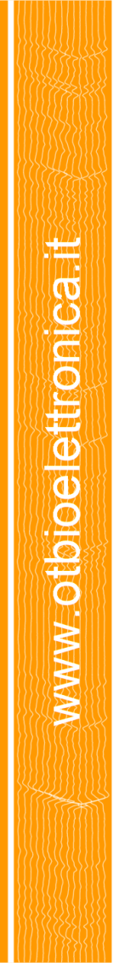

BIOPOTENTIALS, EMG DETECTION
AND PROCESSING
Andrea Bottin
a.bottin@otbioelettronica.it

Slide 2

TOPICS
OT BIOELETTRONICA
BIOPOTENTIALS
EMG GENERATION AND DETECTION
EMG PROCESSING
APPLICATIONS

Slide 3
TOPICS
OT BIOELETTRONICA
BIOPOTENTIALS
EMG GENERATION AND DETECTION
EMG PROCESSING
APPLICATIONS

Slide 4
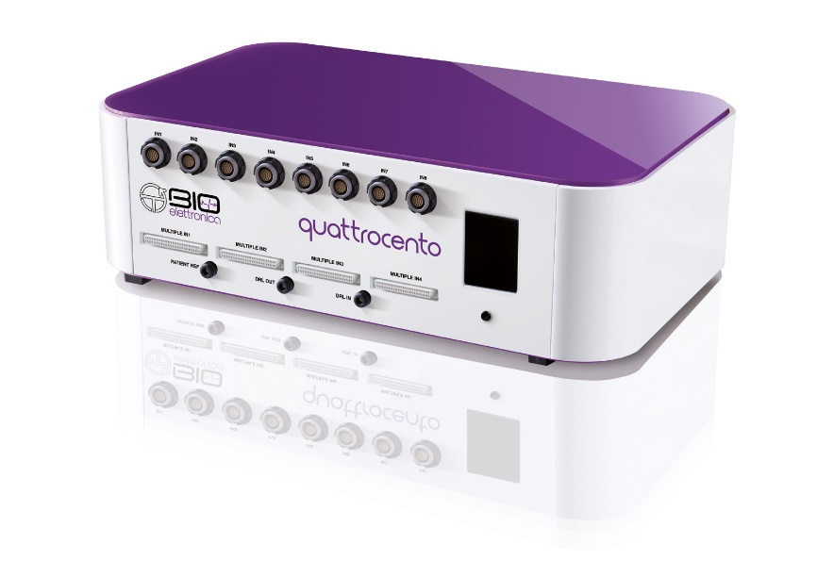
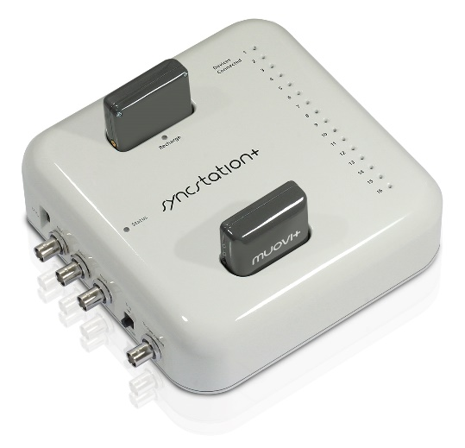
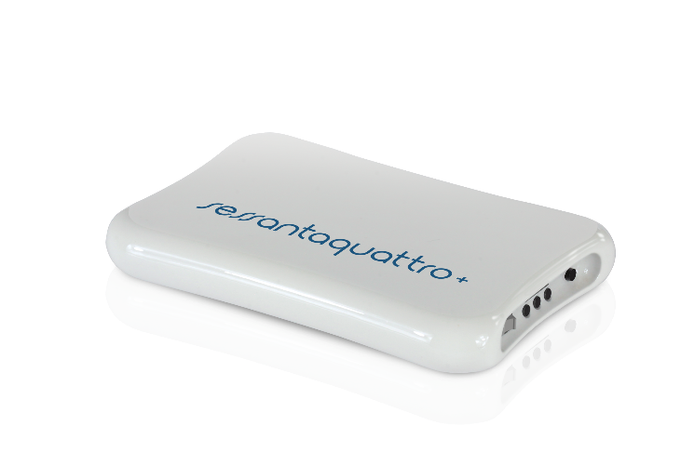
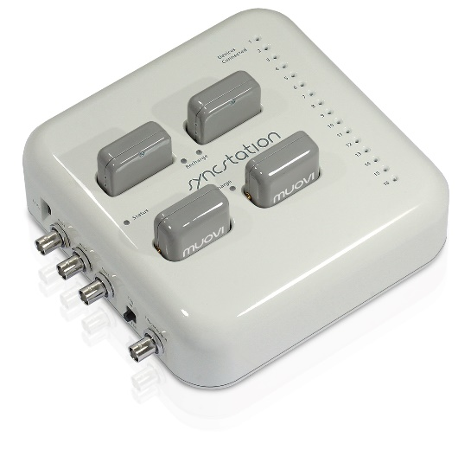
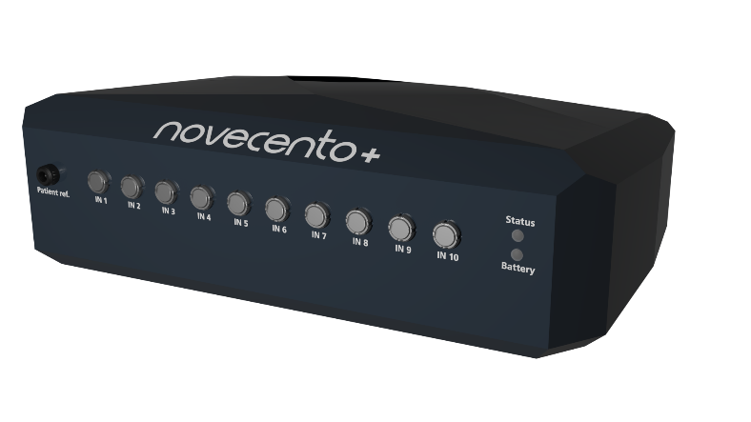
OT BIOELETTRONICA PRODUCTS
Quattrocento
384ch
Muovi+Pro 2x32ch
Novecento+ 960ch
Sessantaquattro+
64ch
MuoviPro 4x32ch
Available since Jne 2024

Slide 5
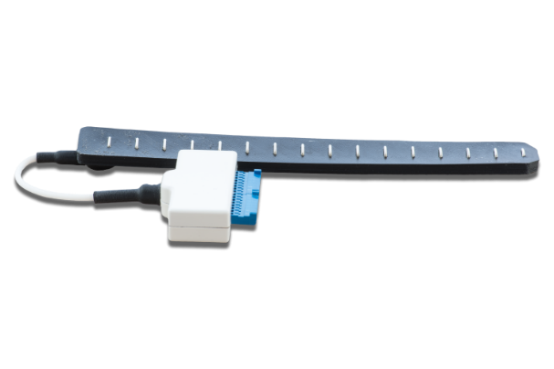
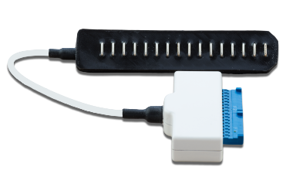
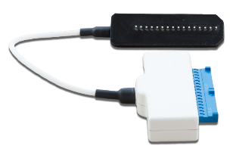
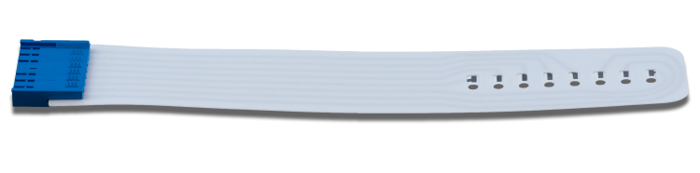
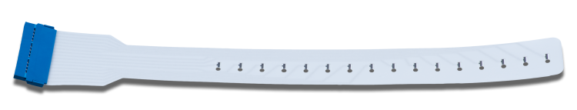
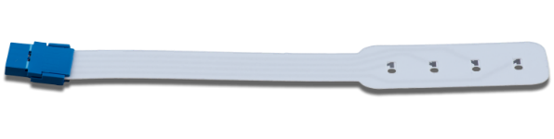
OT BIOELETTRONICA ELECTRODE ARRAYS

Slide 6
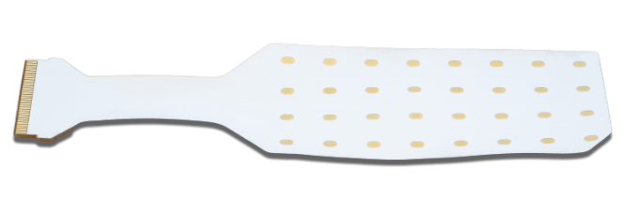
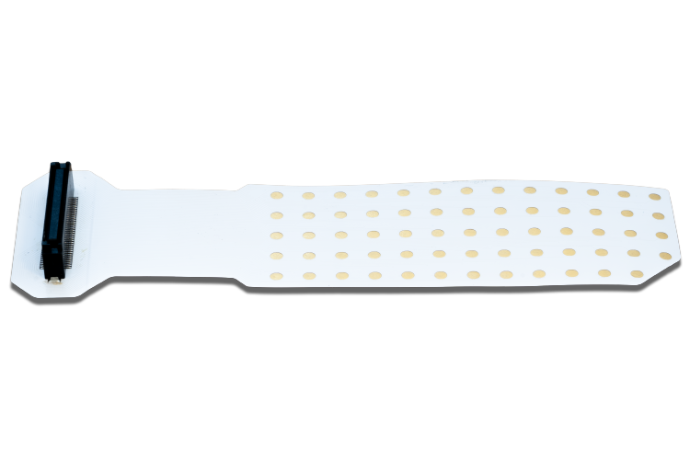
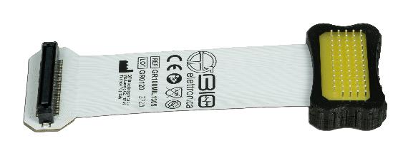
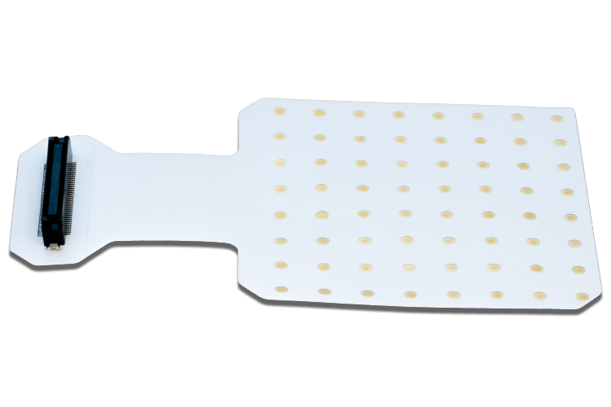
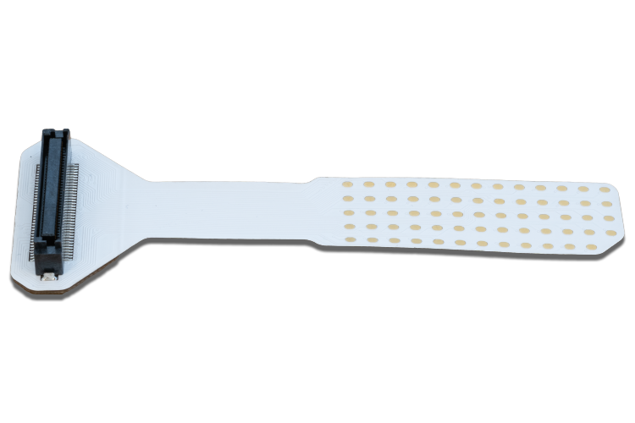
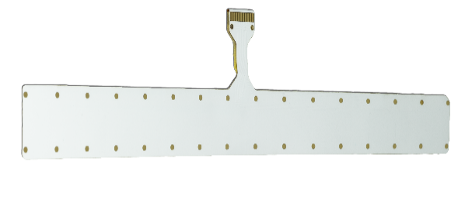
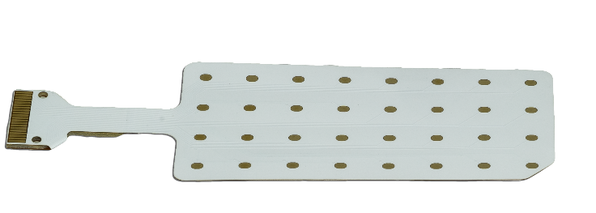
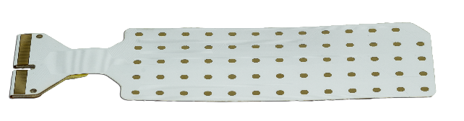
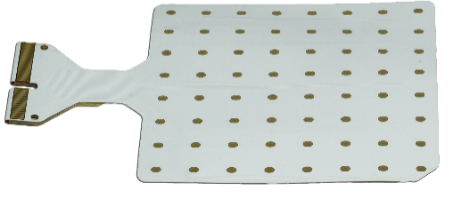
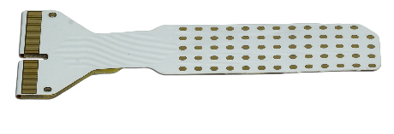
OT BIOELETTRONICA ELECTRODE MATRICES

Slide 7
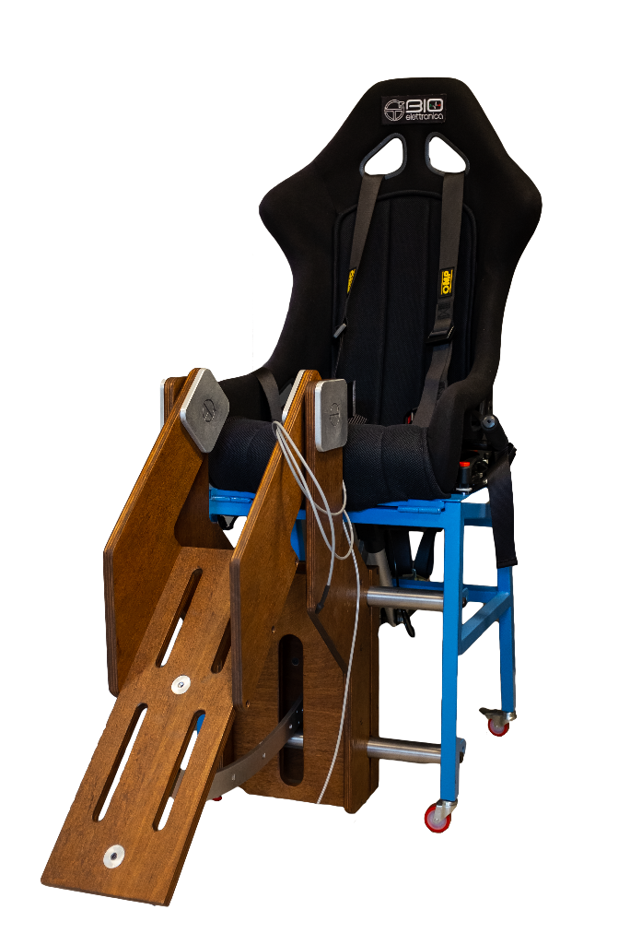
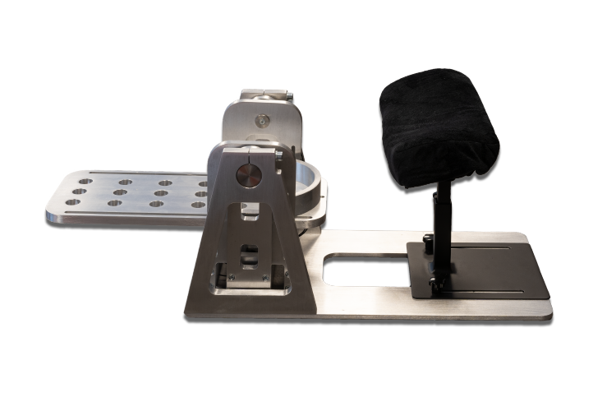
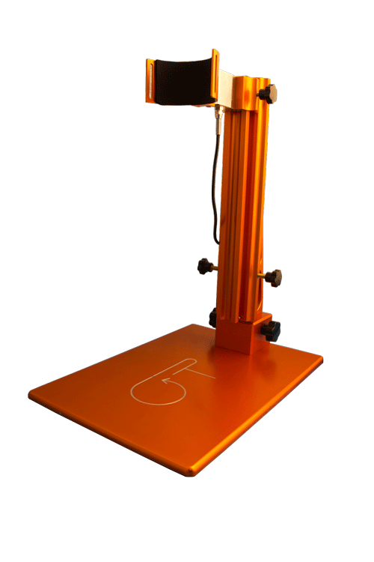
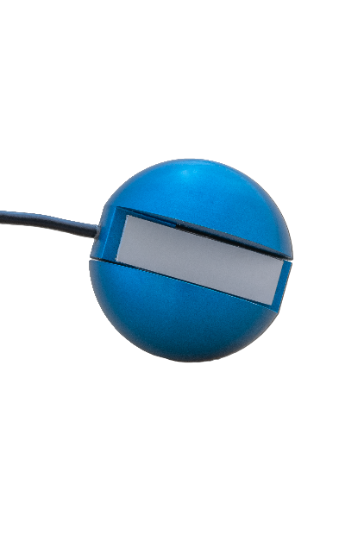
OT BIOELETTRONICA DYNAMOMETERS

Slide 8
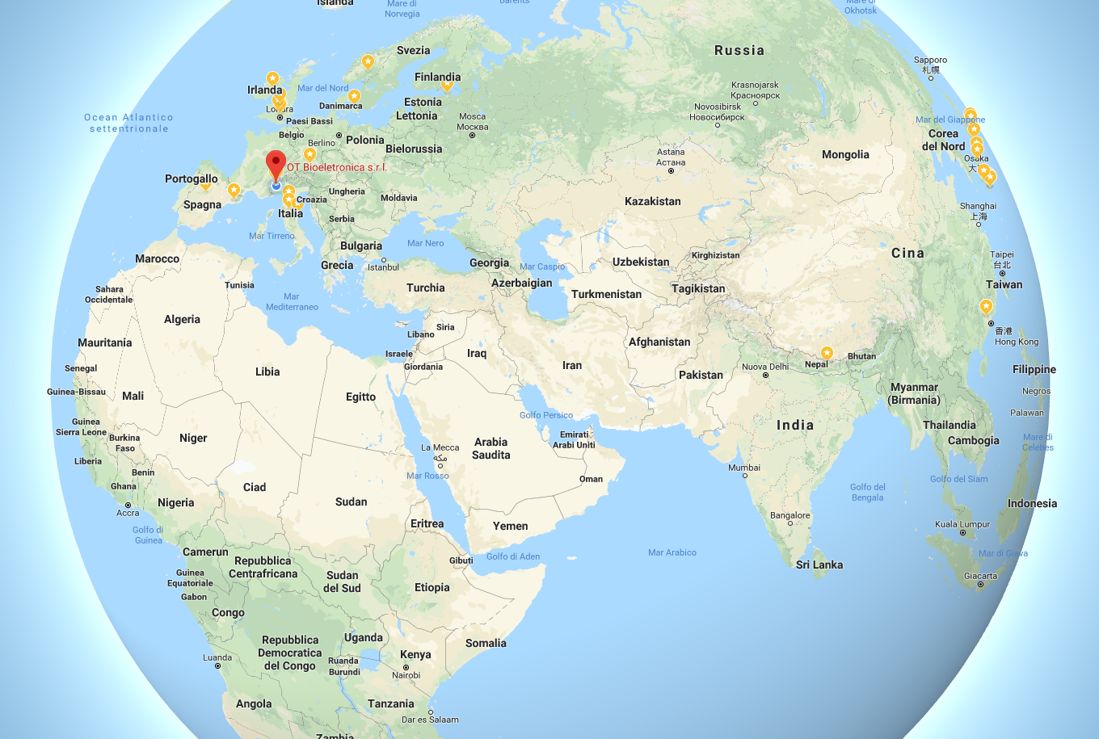
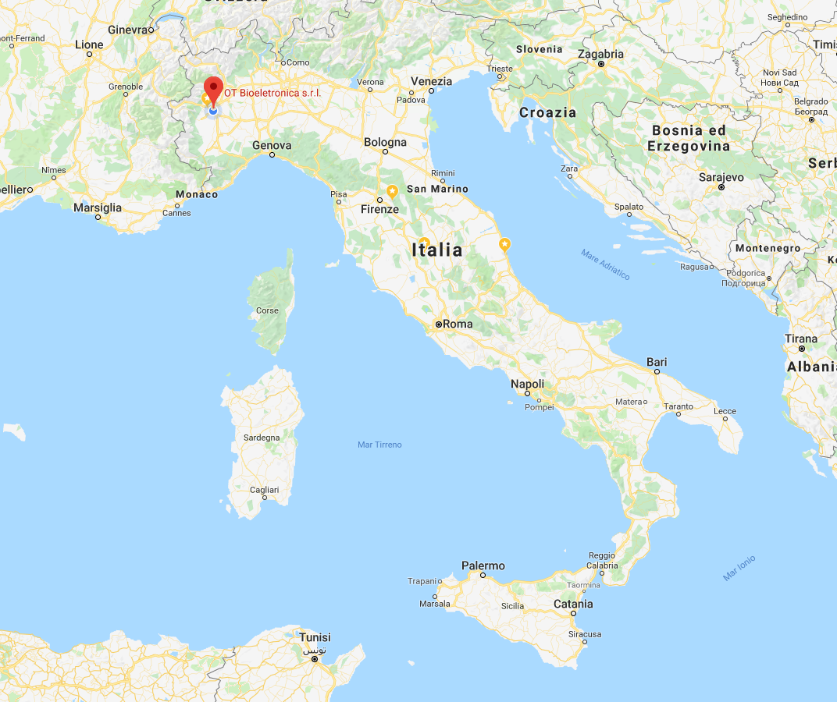
WHERE WE ARE

Slide 9
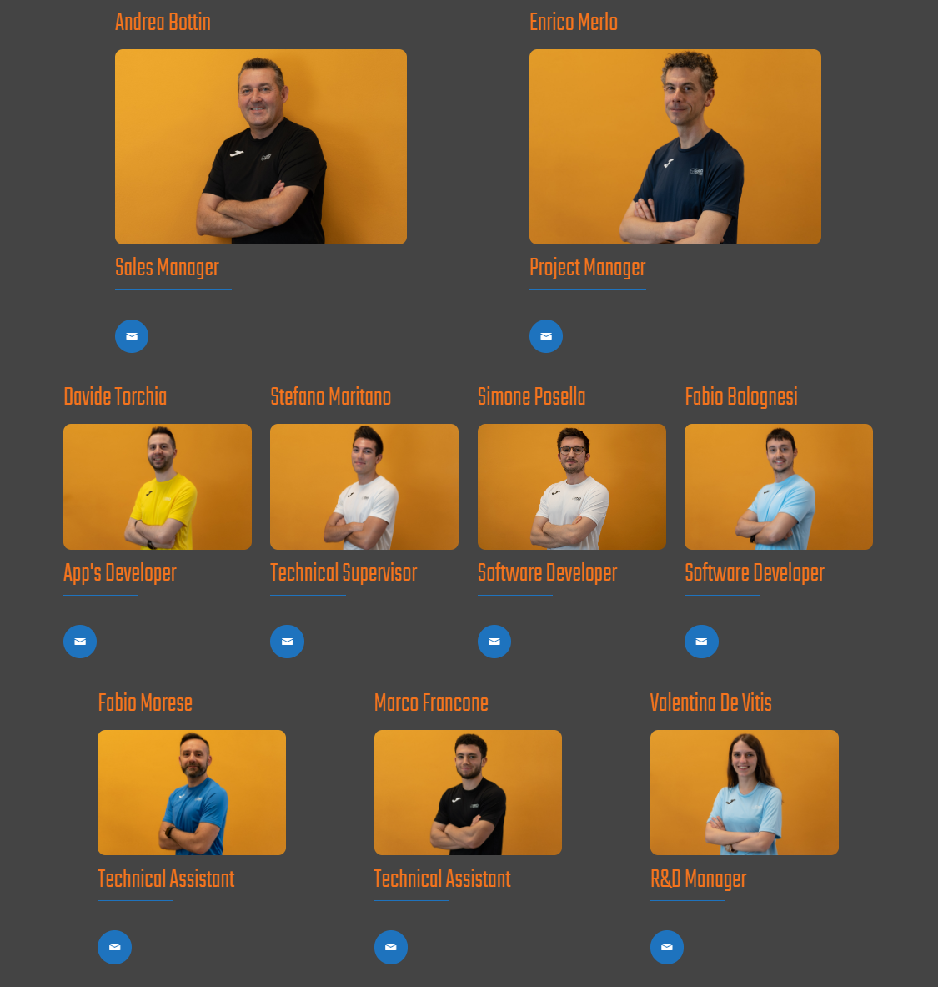
WHO WE ARE

Slide 10
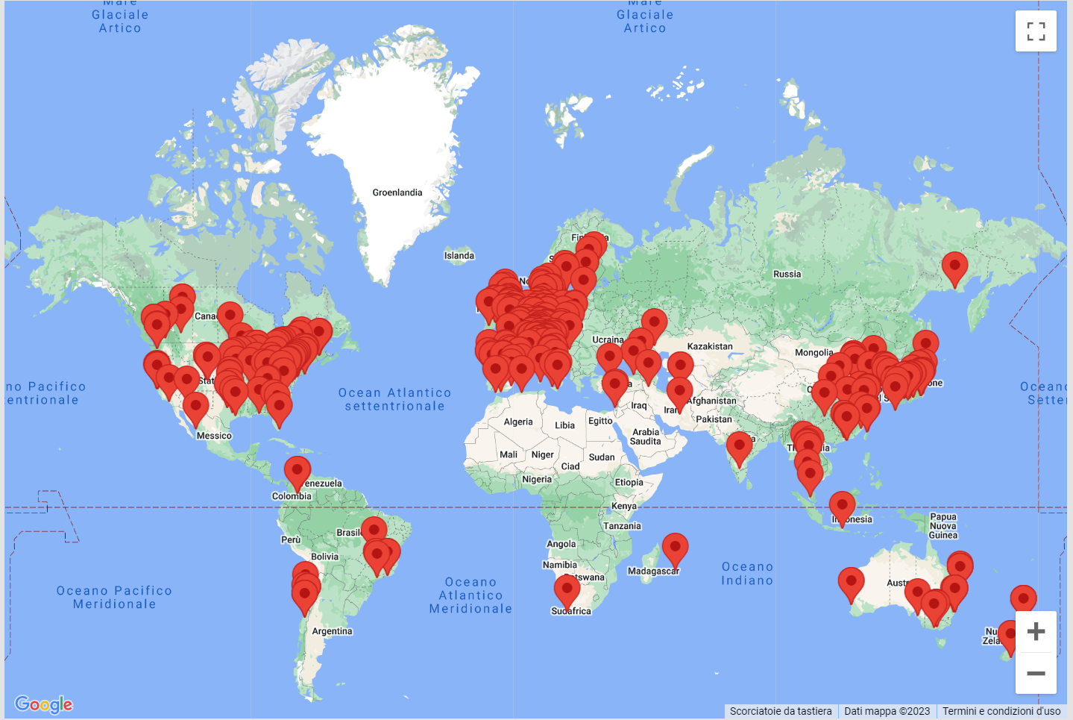
CUSTOMERS AND COLLABORATIONS

Slide 11
TOPICS
OT BIOELETTRONICA
BIOPOTENTIALS
EMG GENERATION AND DETECTION
EMG PROCESSING
APPLICATIONS

Slide 12
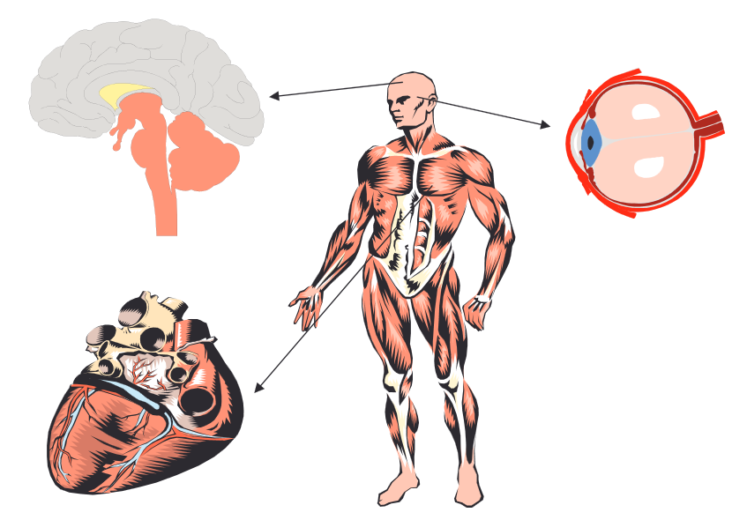
BIOPOTENTIALS
The body produces many different types of biopotentials.
Sources of potentials:
- skeletal muscle (EMG)
- brain (EEG)
- heart (ECG)
eye (EOG)
- stomach (EGG)
The electrical activity can be recorded on the surface of the skin.

Slide 13
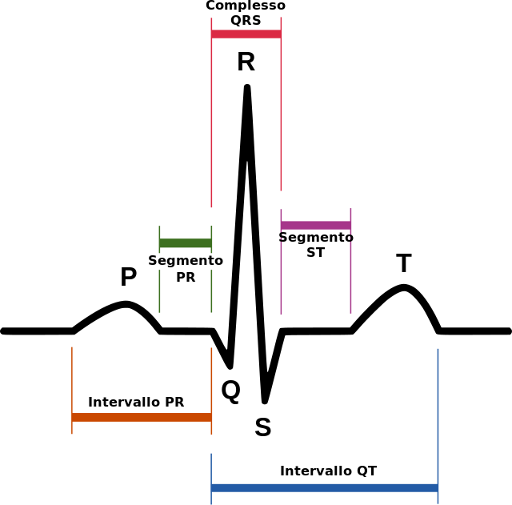
ELECTROCARDIOGRAM - ECG
Most diffused and used biopotential
Known since 1842
Amplitude on the skin: 1 ÷ 5 mV
Bandwidth: 0.5 ÷ 150 Hz
Channels: 1 ÷ 9

Slide 14
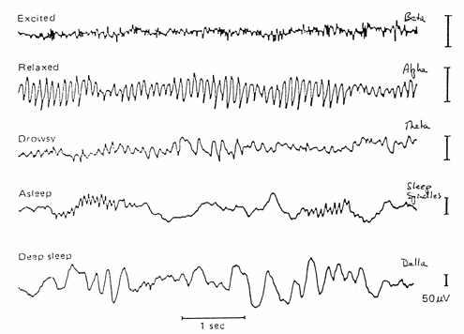
ELECTROENCEPHALOGRAM - EEG
Known since 1929
Amplitude on the scalp: 5 ÷ 200 µV
Bandwidth: 0.5 ÷ 100 Hz
Channels: up to 256

Slide 15
ELECTROENCEPHALOGRAM - EEG
Name | Frequency | Subject condition
Alpha Rhythm | 8 – 13 Hz | Quiet resting activity, eyes closed
Beta Rhythm | 13 – 22 Hz | Awake, attentive state
Delta Rhythm | 0.5 – 4 Hz | Stressful activity or brain disorders
Theta Rhythm | 4 – 8 Hz | Deep sleep, brain disorders
Gamma Rhythm | 22 – 100 Hz | Neural oscillation, transcendental mental states

Slide 16
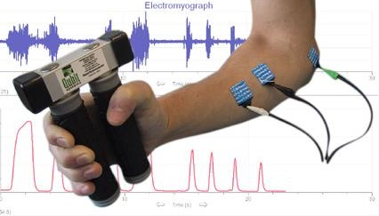
SURFACE ELECTROMYOGRAM - sEMG
Known since 1966
Amplitude on the skin: 5 µV ÷ 10 mV
Bandwidth: 10 ÷ 500 Hz
Channels: up to 400

Slide 17
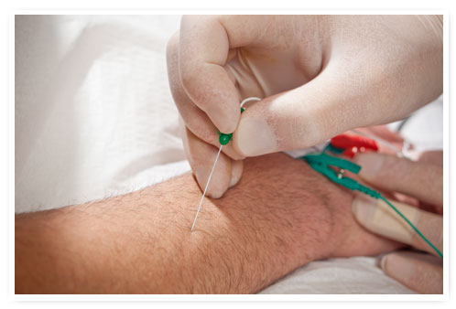
INTRAMUSCULAR ELECTROMYOGRAM - iEMG
Known since 1938
Amplitude: 1 ÷ 5 mV
Bandwidth: 100 ÷ 5000 Hz
Channels: 1 ÷ 4

Slide 18
TOPICS
OT BIOELETTRONICA
BIOPOTENTIALS
EMG GENERATION AND DETECTION
EMG PROCESSING
APPLICATIONS

Slide 19
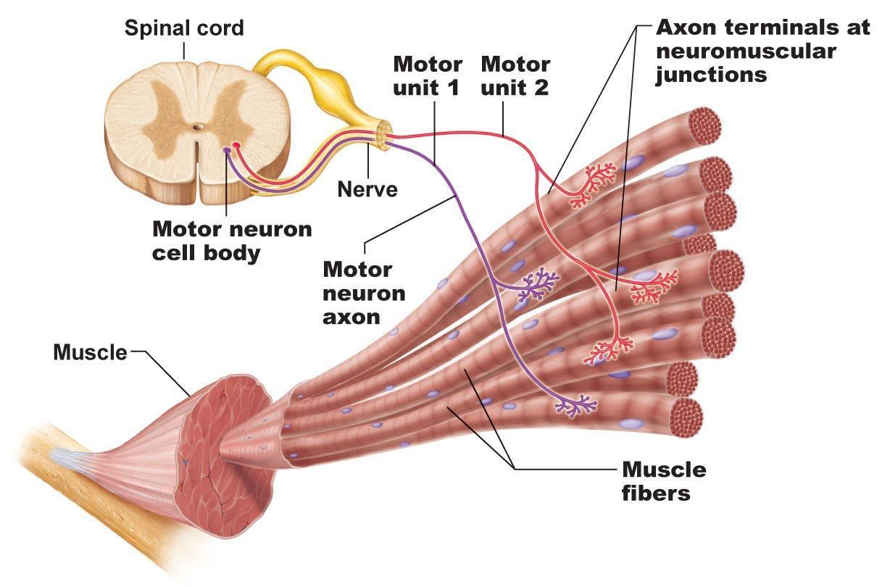
MOTOR UNITS
Notes:
Electrical event to a mechanical event

Slide 20
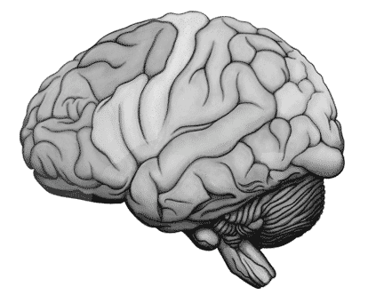
MOTOR UNITS ACTION POTENTIAL
MU_2
Motor cortex
α motor neurons
Conduction velocity: 6 m/s
MU_1
Conduction velocity: 4 m/s
Innervation zone

Slide 21
RECORDING EMG FROM THE SKIN SURFACE
MUAPs
⬇
MUAPs
⬇
Innervation zone
⬇
Electrode
⬇
Tendon➔
Skin
MU_1
MU_2
Filter
MU_3

Slide 22
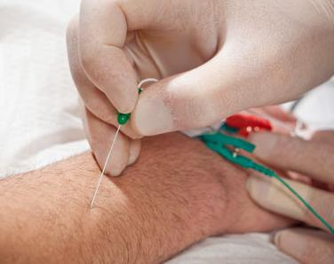
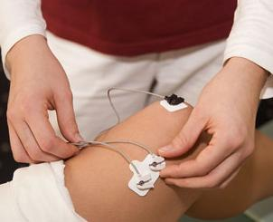
Intramuscular EMG - (iEMG)
sEMG vs iEMG
100 ms
Surface EMG - (sEMG)
100 ms

Slide 23

sEMG vs iEMG
iEMG
sEMG
3.32
3.34
3.36
Time (s)
3.38
3.4
3.42

Slide 24
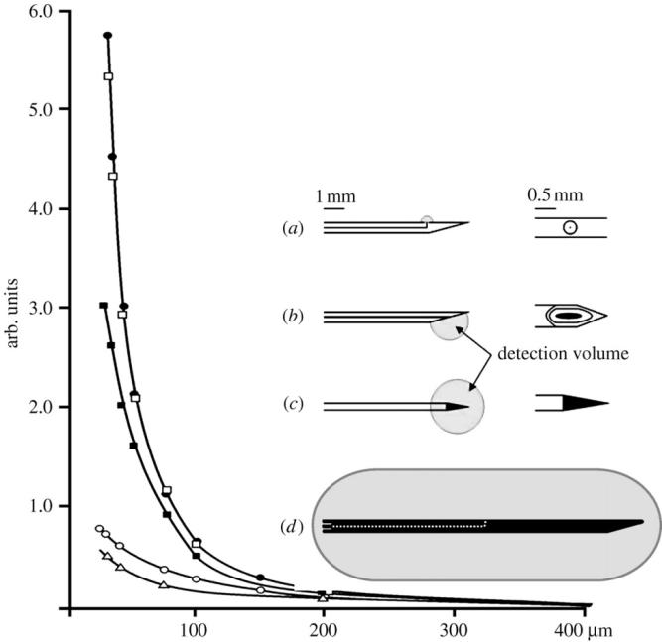
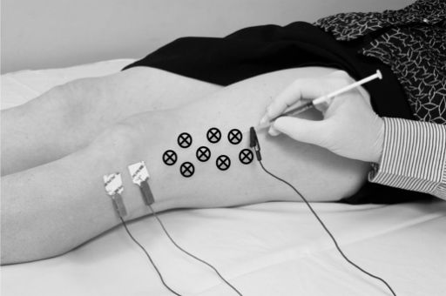
INTRAMUSCULAR NEEDLE ELECTRODES
The different types of needle electrodes have different recording
volumes covering different portions of a motor unit territory.

Slide 25
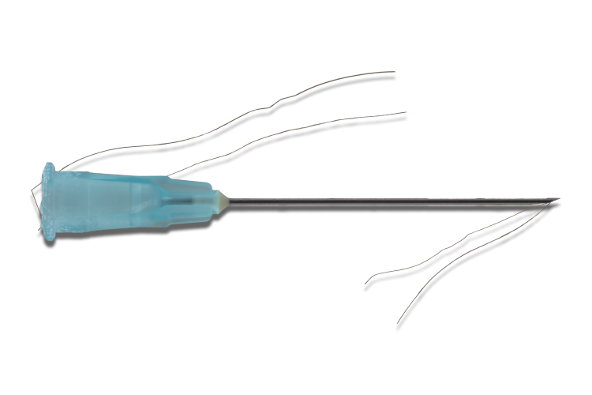
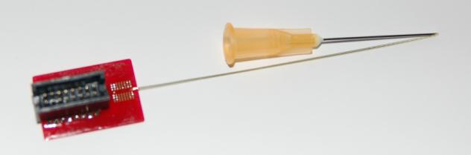
INTRAMUSCULAR WIRE ELECTRODES
Thin wire inserted with a needle
After insertion the needle can be removed
Only the tip of the wire is exposed
Allows the detection during movements
Guiding Filament
Insertion Needle
Multipoint intramuscular detection
Developed in Germany at UMG
Connection Pad
Array
Electrode Line

Slide 26
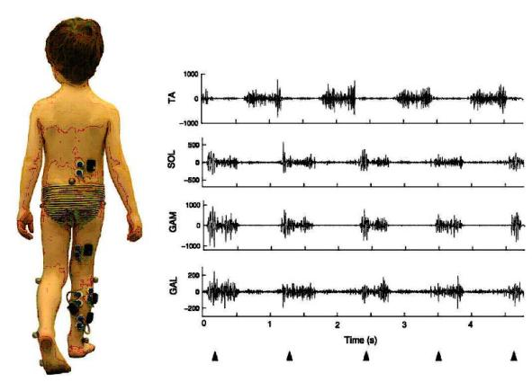
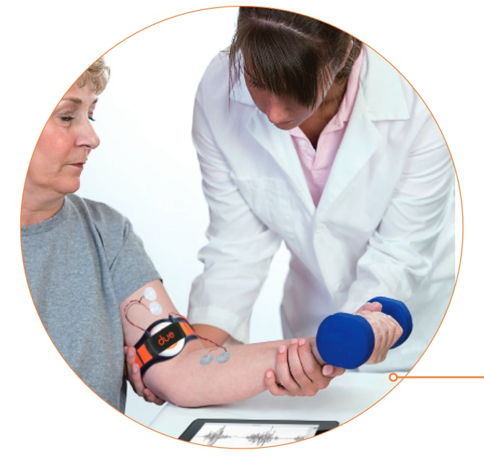
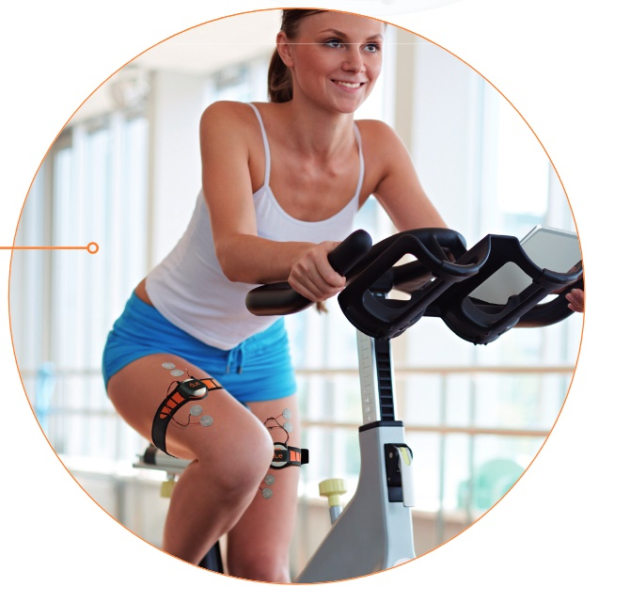
BIPOLAR SURFACE EMG DETECTION

Slide 27
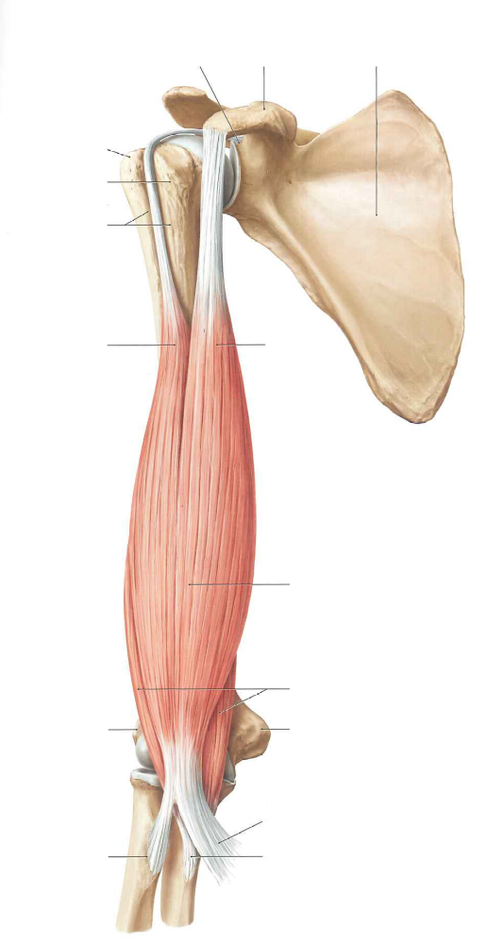
BIPOLAR PLACEMENT
Proper Bipolar placement
Wrong Bipolar Placement

Slide 28
MULTICHANNEL sEMG DETECTION MODES
Monopolar
Bipolar or single differential
Linear electrode array
Second electrode at “zero” potential

Slide 29

SIGNATURES OF MOTOR UNITS
tendon
Innervation
Zone
Channel with smaller amplitude, possibly near or over the innervation zone.
Three SD channels provide some additional information
With 7 channels we begin to see patterns that might be the “signatures” of motor units
tendon

Slide 30



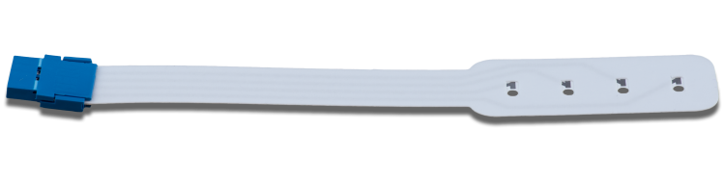
ELECTRODE ARRAYS
DRY ARRAYS
Suitable only for short term acquisition and for the location of the best position on the muscle
ADHESIVE ARRAY
Suitable for long term acquisition and for dynamic contractions

Slide 31
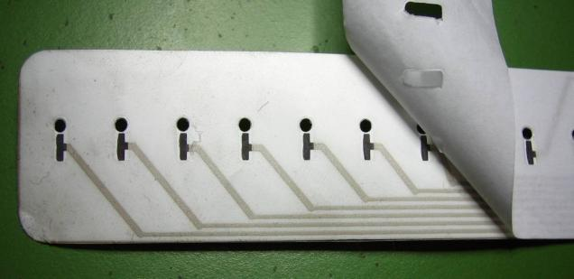

ADHESIVE ELECTRODE ARRAY AND GRIDS PLACEMENT
Silver chloride electrodes
Holes for the gel insertion
Holes for the exposure of electrodes
Mylar support layer
Siliconic paper for the insulation of traks
Silver deposed with serigraphic process
Electrode support
Double adhesive foam
Skin

Slide 32
HIGH DENSITY SURFACE EMG (HD-sEMG)
Monopolar
Bipolar
Linear electrode array
2D electrode array
(HD-sEMG)

Slide 33
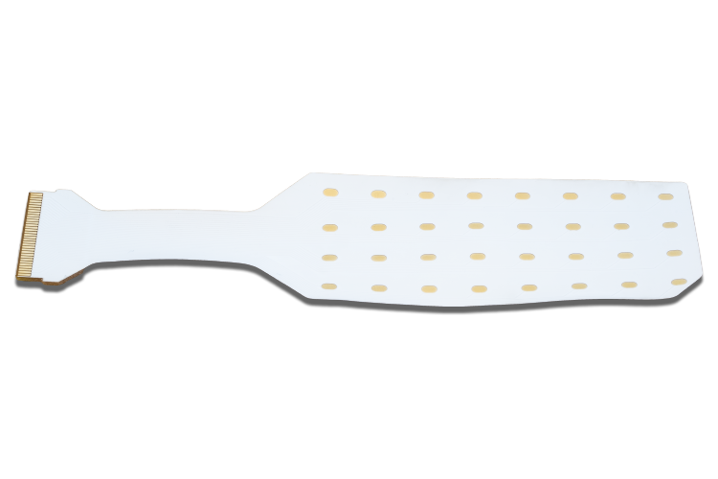

ELECTRODE MATRICES

Slide 34



iEMG VS sEMG VS HD-sEMG
iEMG
sEMG
HD-sEMG
Non-Invasive (no pain)
No cross-talk
Exact estimation of conduction velocity
Discharge rate estimation
Estimation of MU recruitment thresholds
Detection area
Easy to perform
No danger
(no risk of infections)

Slide 35
TOPICS
OT BIOELETTRONICA
BIOPOTENTIALS
EMG GENERATION AND DETECTION
EMG PROCESSING
APPLICATIONS

Slide 36






HOW EMG CHANGE
Relationship EMG-Force
Relationship EMG-Fatigue
MUSCLE FATIGUE

Slide 37



FREQUENCY CONTENT

Slide 38
MANIFESTATIONS OF MUSCLE FATIGUE
TIME
A.U.
MUSCLE FATIGUE
A.U.
FREQUENCY

Slide 39
CONDUCTION VELOCITY - CV
4cm
10ms
Space
Time
V = S/t

Slide 40
CONDUCTION VELOCITY CHANGES WITH FATIGUE
4cm
4cm
4cm
4cm
10ms
12ms
15ms
18ms
Space
Time

Slide 41
EMG VARIABLES DURING MUSCLE FATIGUE
70
Isometric contraction 70%±5% MVC
60
Torque
(%MVC)
50
40
30
Muscle fatigue
20
10
6
Endurance time
Decrease of muscle fiber conduction velocity
CV
(m/s)
5
4
Decrease of spectral frequency content
80
MNF
(Hz)
60
40
Increase of EMG amplitude
(MUAP slow down)
0.3
ARV
(mV)
0.2
0.1
Decrease of FD
(MU synchronization)
1.55
Fractal
Dimension
1.54
1.53

Slide 42


ACTIVATION MAP

Slide 43

EMG DECOMPOSITION
Electrode grid
Surface EMG signals
summation of all active MUs
Firing patterns
α-motoneurons
MUs Reppresentation on each electrode

Slide 44


EMG DECOMPOSITION RESULT

Slide 45


EMG DECOMPOSITION RESULT

Slide 46
TOPICS
OT BIOELETTRONICA
BIOPOTENTIALS
EMG GENERATION AND DETECTION
EMG PROCESSING
APPLICATIONS

Slide 47

AMYO PROJECT
Advanced Myoelectric Control of Prosthetic Systems
European Project involving Ottobock, OT Bioelettronica, UM Goettingen, TU Berlin
Detection of EMG from the forearm to drive a multiple degree of freedom prostetic hand in a new intuitive way

Slide 48


TARGETED MUSCLE REINNERVATION

Slide 49

MuoviPro
4 x 32 sEMG channel device with Wi-Fi communication

Slide 50

MuoviPro
2 x 64 sEMG channel device with Wi-Fi communication

Slide 51

MuoviPro & Muovi+Pro options
muovi+
due+
due+
Up to 8
muovi+
due+
64
EMG/EEG
2 EMG
2 EMG
64
EMG/EEG
2 EMG
quattro+
muovi
32
EMG/EEG
4 EMG
quattro+
muovi
32
EMG/EEG
4 EMG
SyncStation
32 EMG/EEG
optional
muovi
Ethernet
32 EMG/EEG
Sync output
muovi
3 AUX input
±5 V
WiFi
& Sync pulses
Load cell input

Slide 52


KINELOCK

Slide 53

BRUXOFF – BRUXISM DIAGNOSIS

Slide 54




NOD – THREE FUNCIONS FOR PHYSIOTHERAPISTS
Dynamometer
The Hand-Held Dynamometer is a portable device used for muscle strength measurement
Force Biofeedback
The force biofeedback is the technique of providing a real-time information of the force produced by the neuromuscular contraction.
Algometer
The algometer is a clinal and research tool for the assessment of the musculoskeletal pain.

Slide 55
THANK YOU

