Slide 1
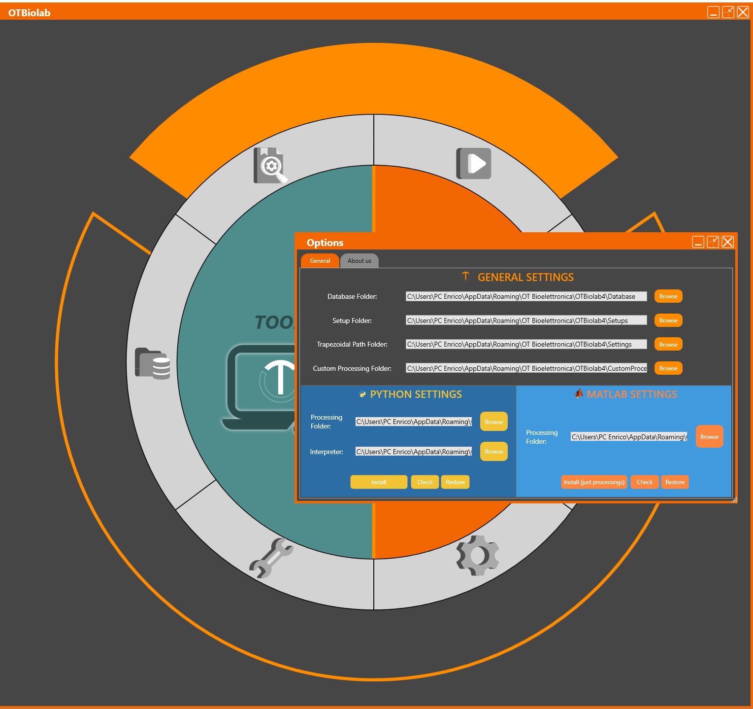
Realignment of signals acquired with MuoviPro and Muovi+Pro
The file acquired from muovi/muovi+ and SyncStation are acquired independently from one device to another. The command to start the acquisition is sent from SyncStation to the probes through WiFi. The commands can arrive to the probes with delays. Thus, the acquisition of the singlas on the different probes can start not exactly at the same time. Moreover, the different probes can have a slightly different internal clock and the sampling frequency can vary with a maximum difference of 50 ppm.
The software OTBioLab25 can be used to re-align the signals acquired. In fact, the SyncStation send radiofrequency Sync pulses to the probes. The pulses are recorded together with the EMG signals and the software, using these Sync pulses can realign the acquisitions.
Follow this guide to realign your signals:
Download, install and run OTBioLab25 (it is free, you can download it from the download section of the website: otbioelettronica.it
From the main screen, open support window
Then install the Python tools
For details about Python tools,
check this tutorial video: https://youtu.be/J9r8d3Ccl7w

Slide 2
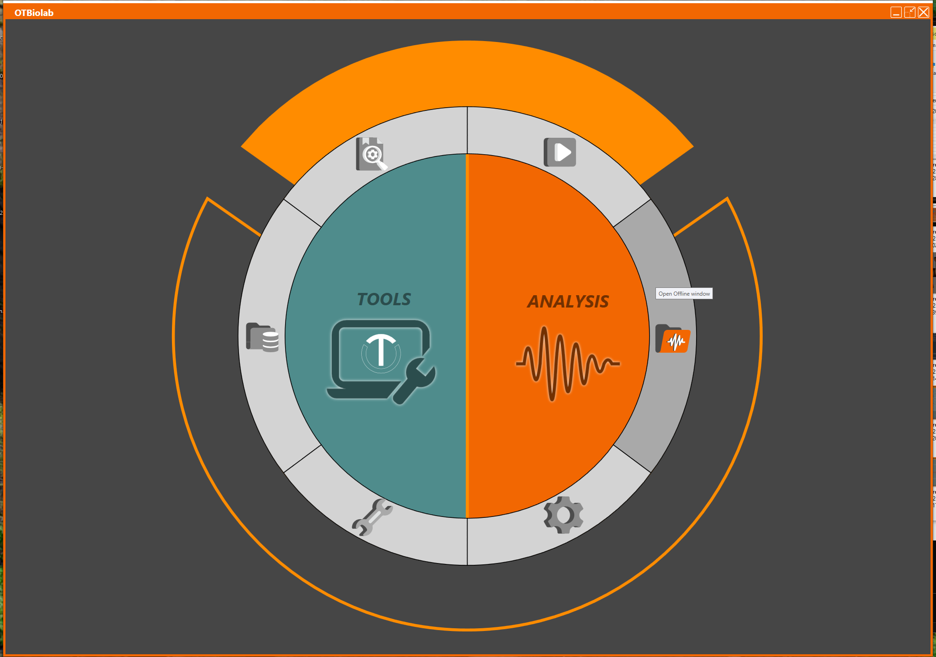
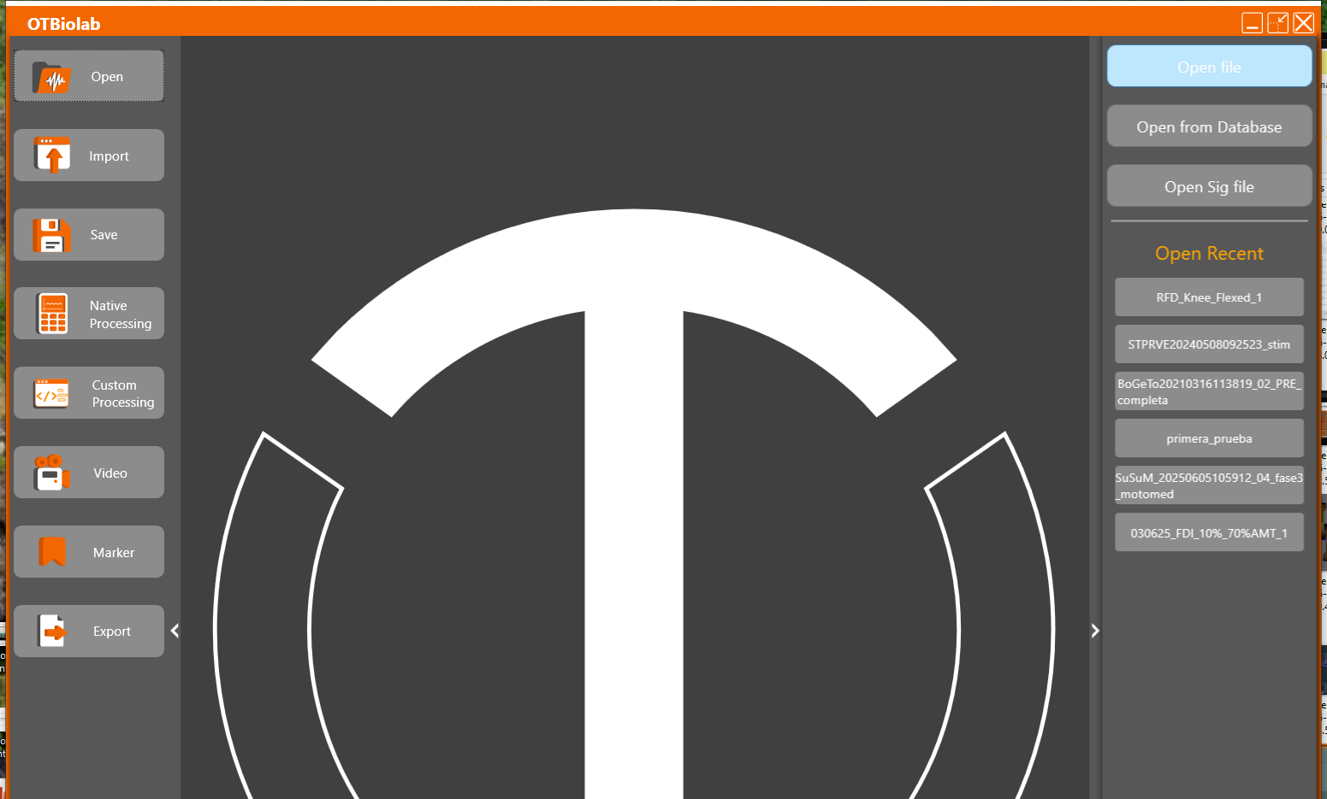
4. Click on the open button in the main screen
5. Click on the open button
6. Click on the open file button and browse on your computer to open the desired file

Slide 3
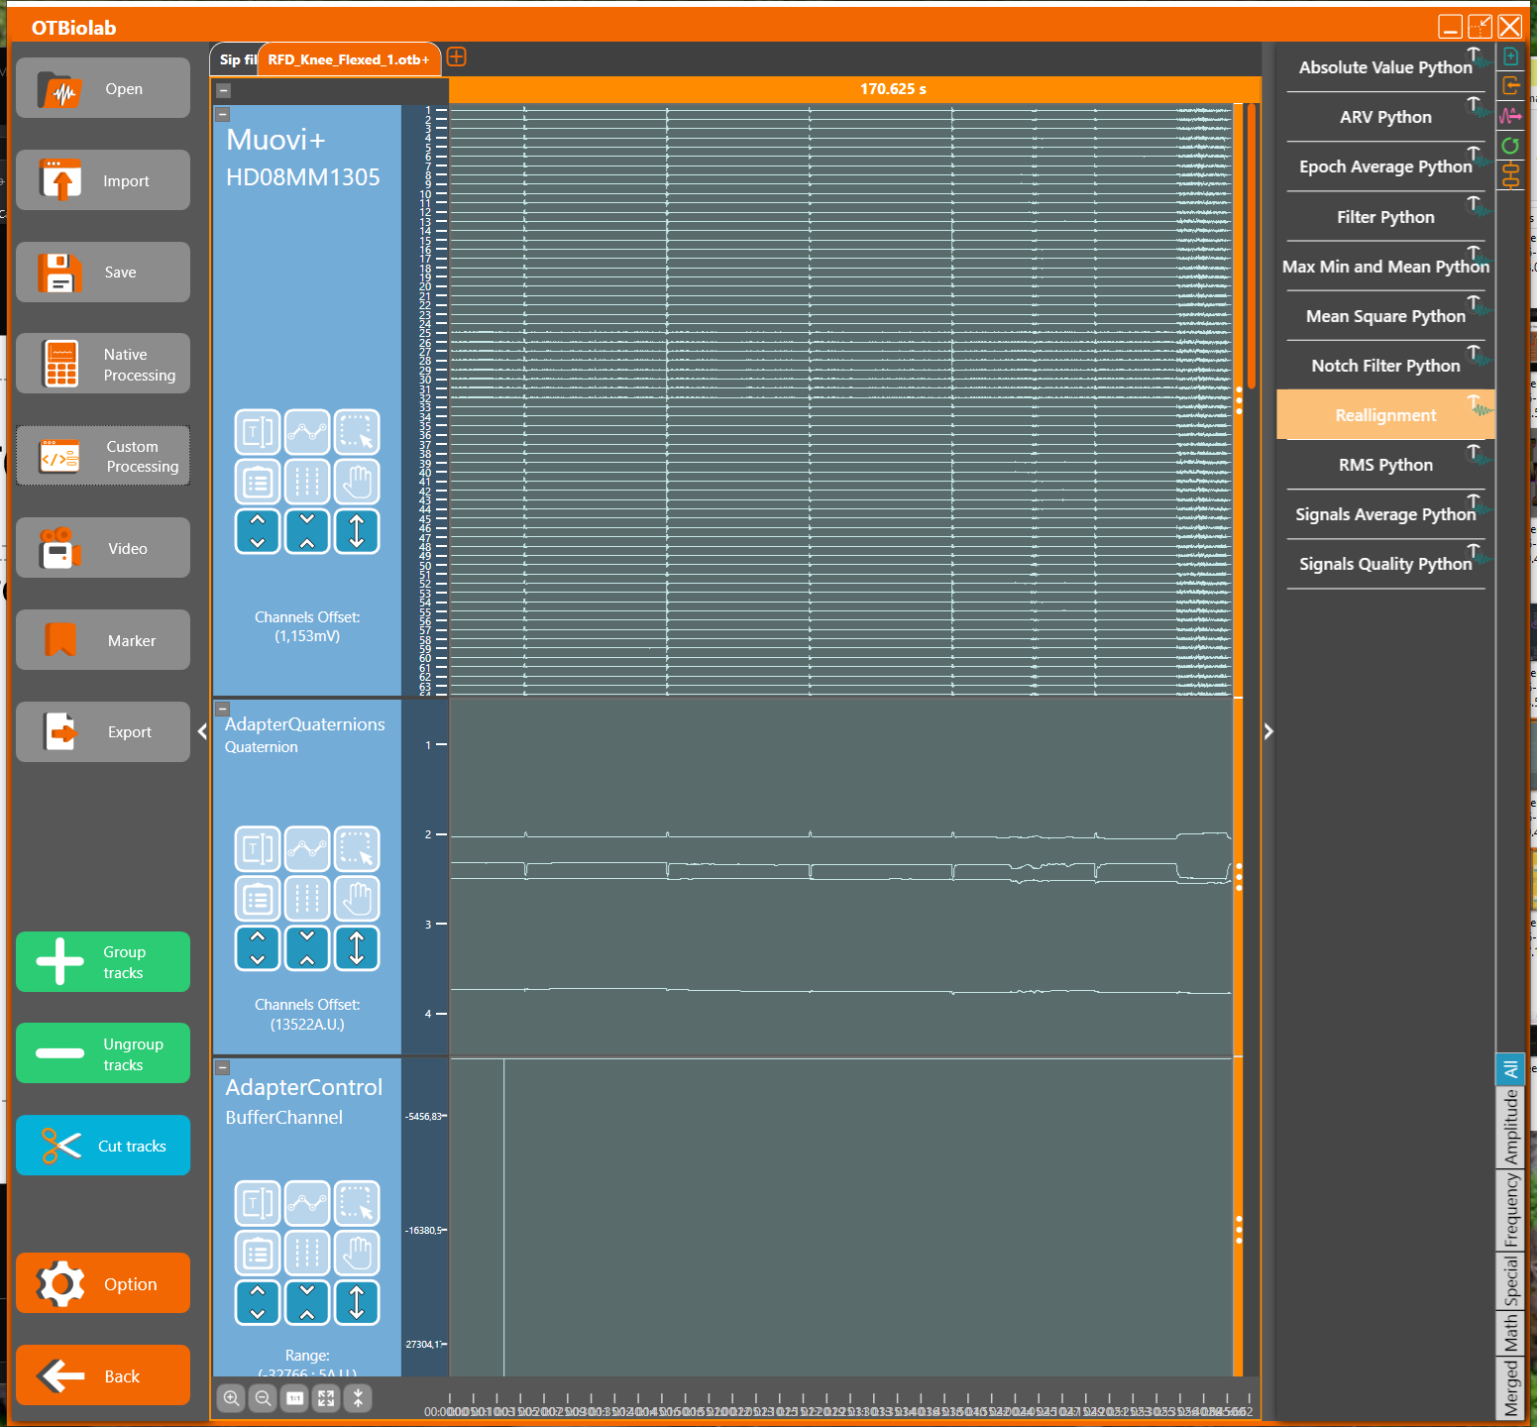
7. Click on the Custom Processing
8. Select the processing «Realignment»
If the processing is not in the list, check that you have properly installed the Python tools

Slide 4
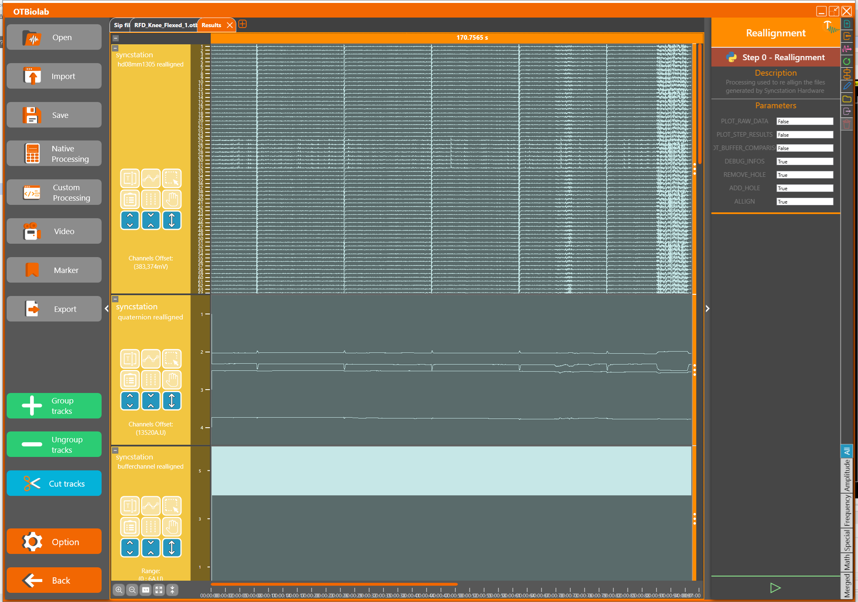
9. Check that the last three options are set on True. If not, delete the content of the textbox and write «True»
10. Run the processing and wait

Slide 5
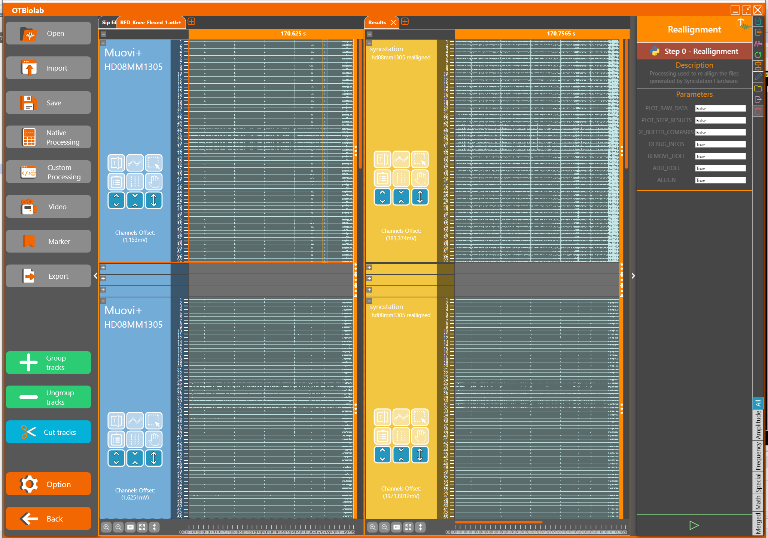
11. At the end of the processing a new tab «result» appear.
In this figure the tab result has been moved beside the raw signals
12. To check the realignement, select a small portion of file both in the original file and in the realigned files and zoom to selection

Slide 6
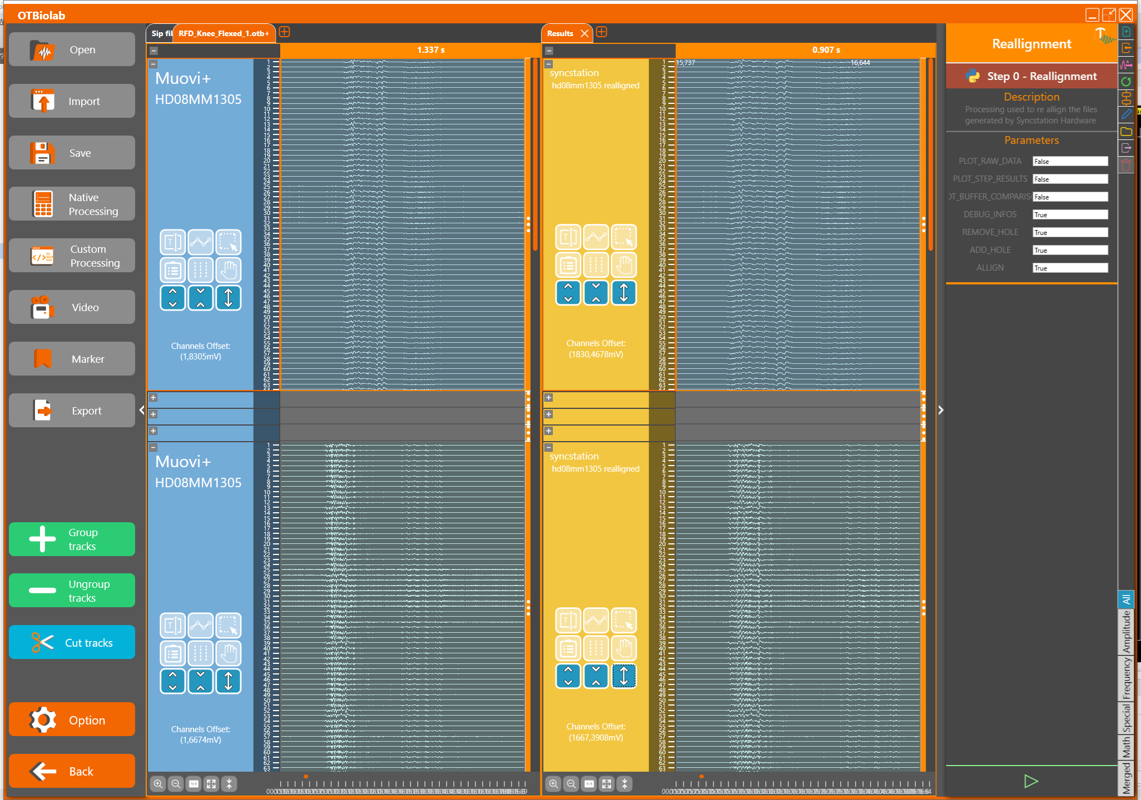
13. Check that the dealy between the signals recorded from different probes has been cancelled

Slide 7
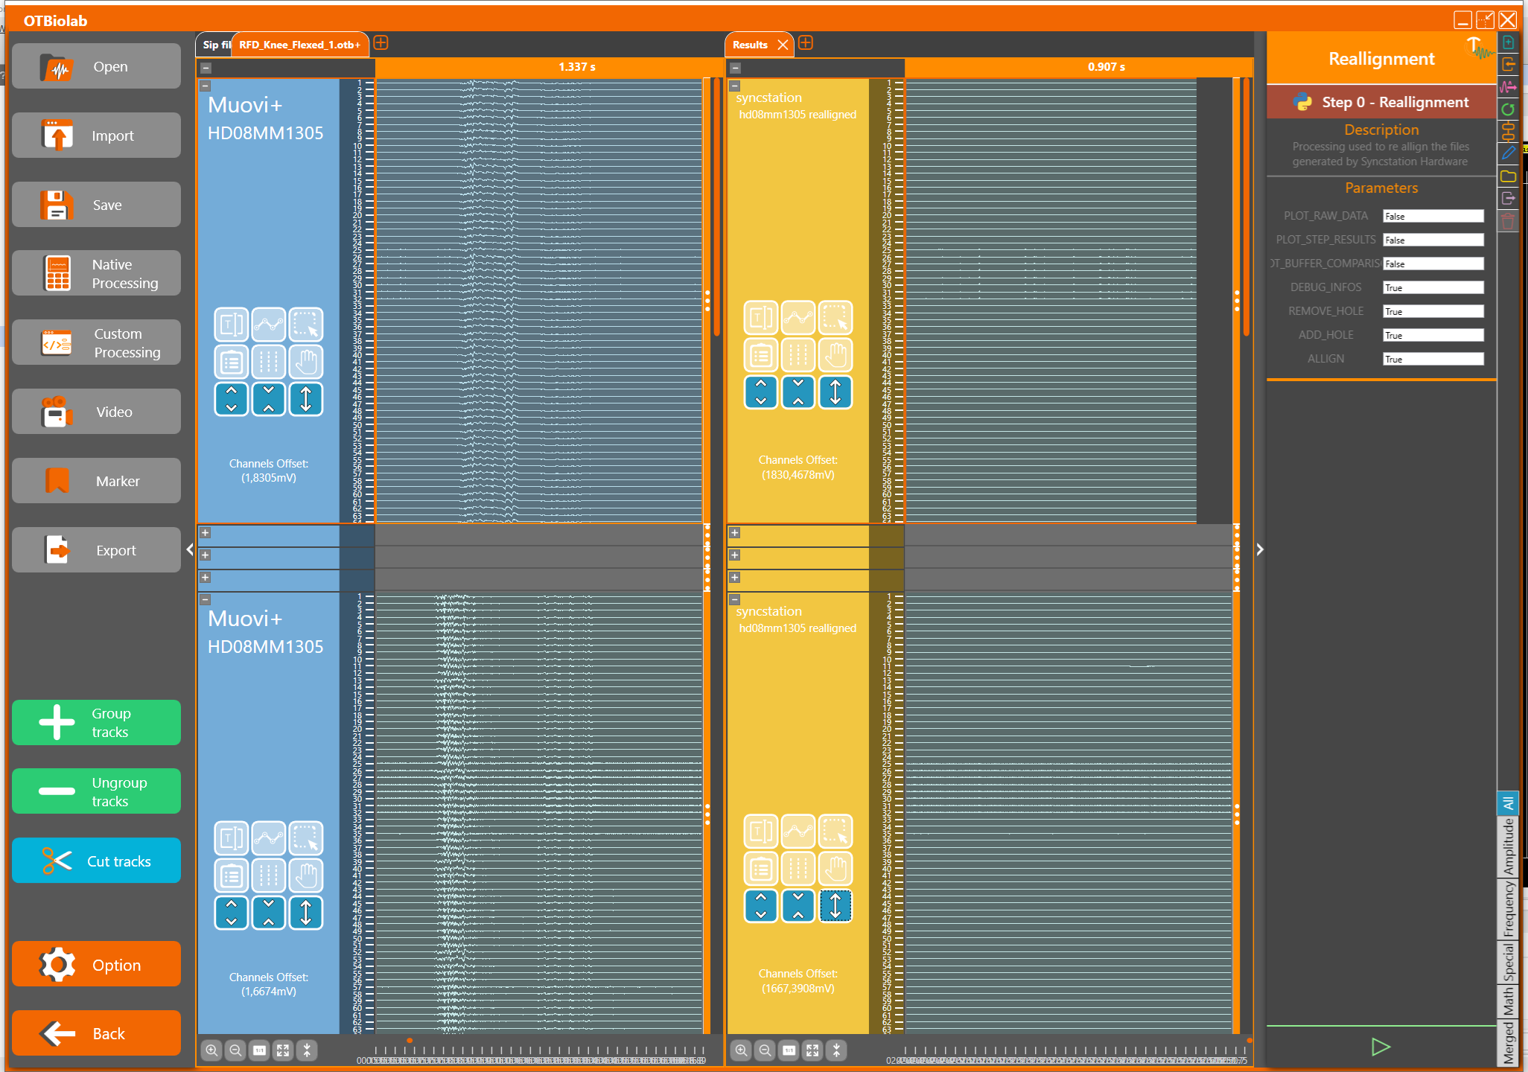
14. Additionally, go at the end of file to check that now the recordings from different probes end no longer at the same time.
15. This recording now ends a bit earlier than the other one due to the time shift to realign the signals

Slide 8
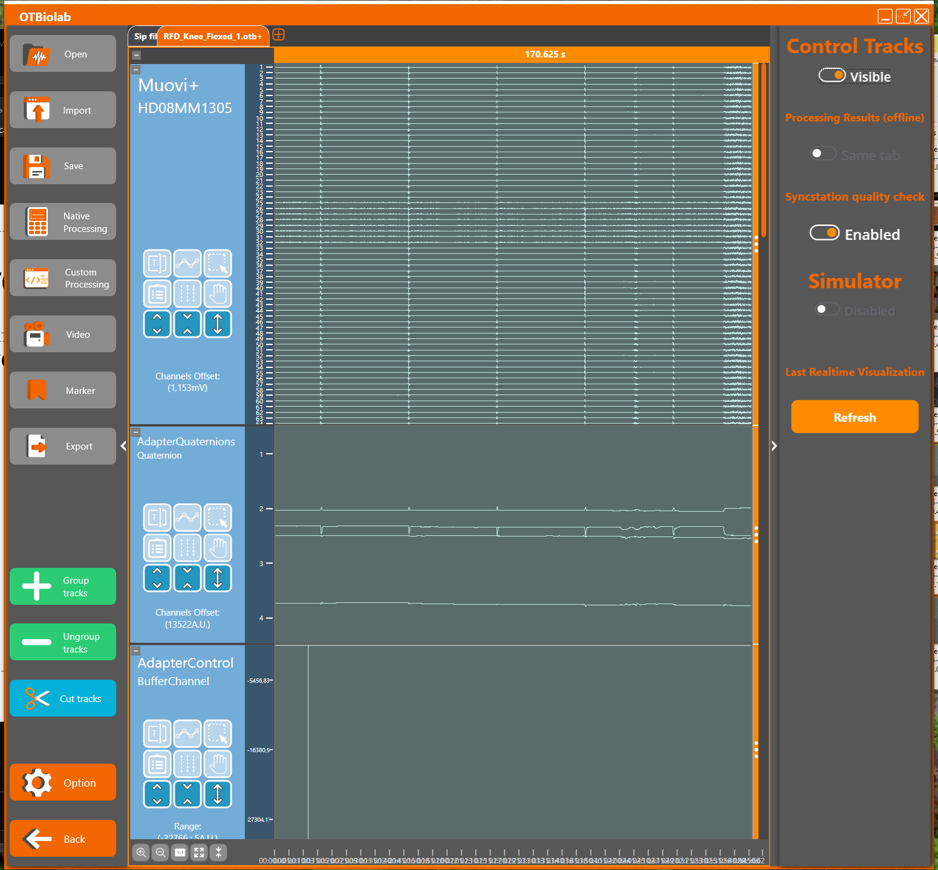
16. In case, you can also check the the Sync pulses and see if they are properly realigned. Enable the control tracks with Option and then make the tracks visible

Slide 9
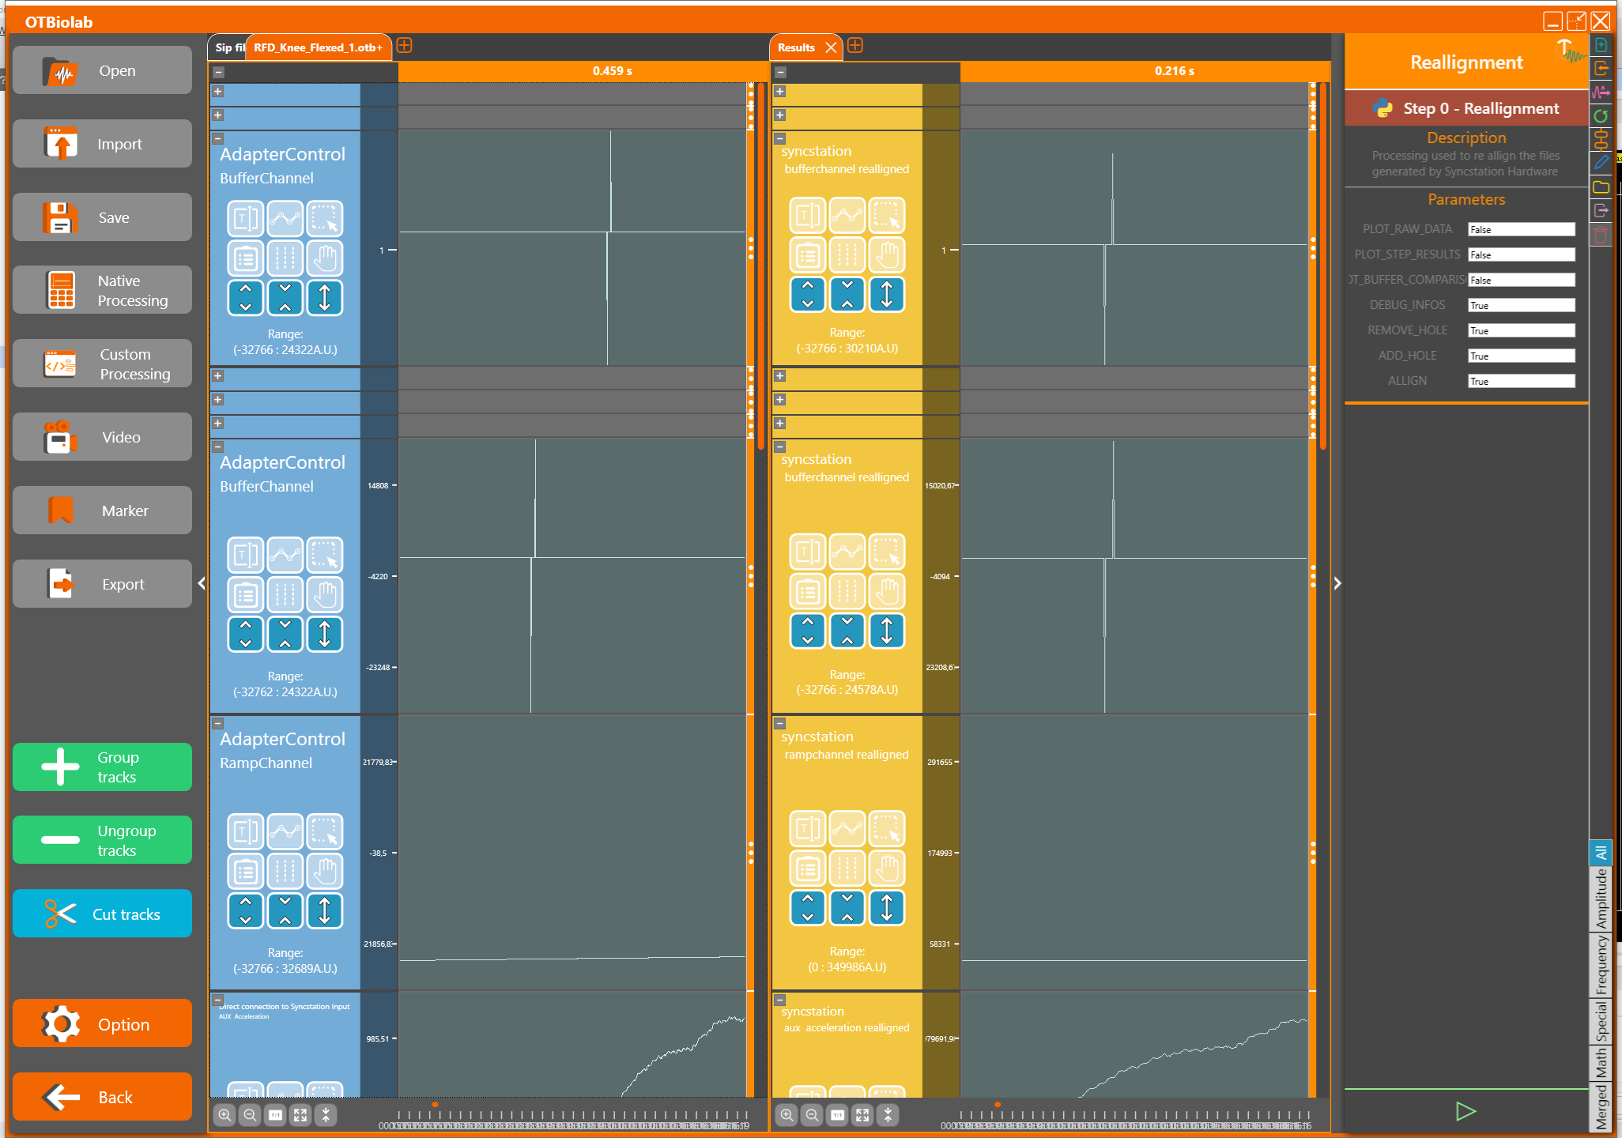
The sync pulses are on the buffer channel of the probes (see user manual for details.
The sync pulses are not perfectly aligned in the raw signals but have been realigned by the processing

