Slide 1
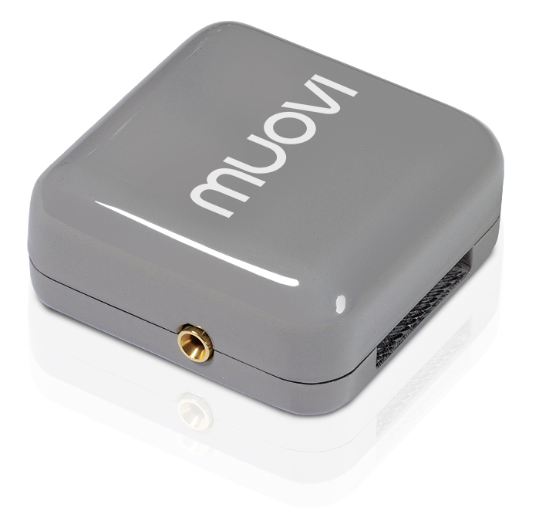
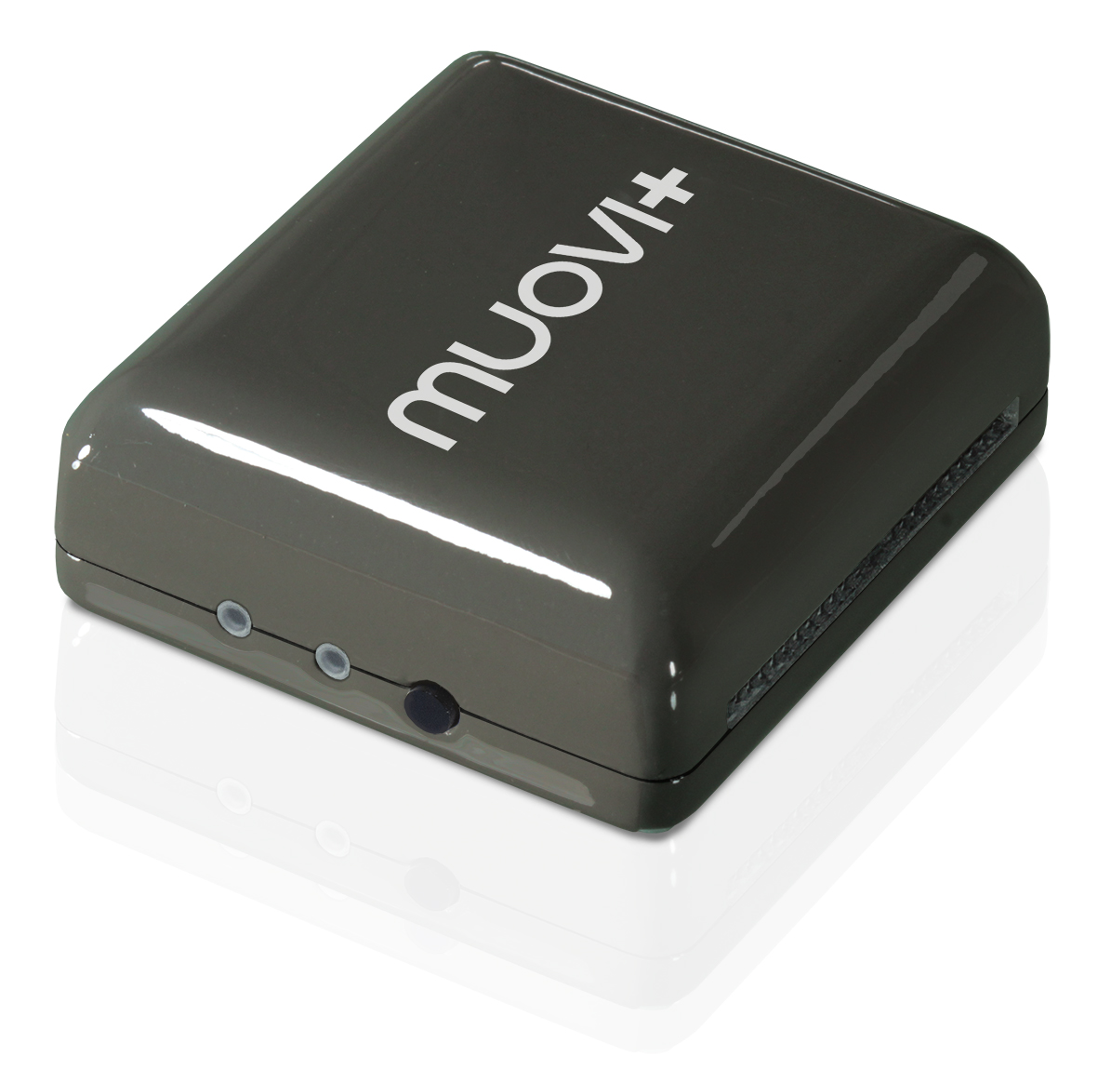
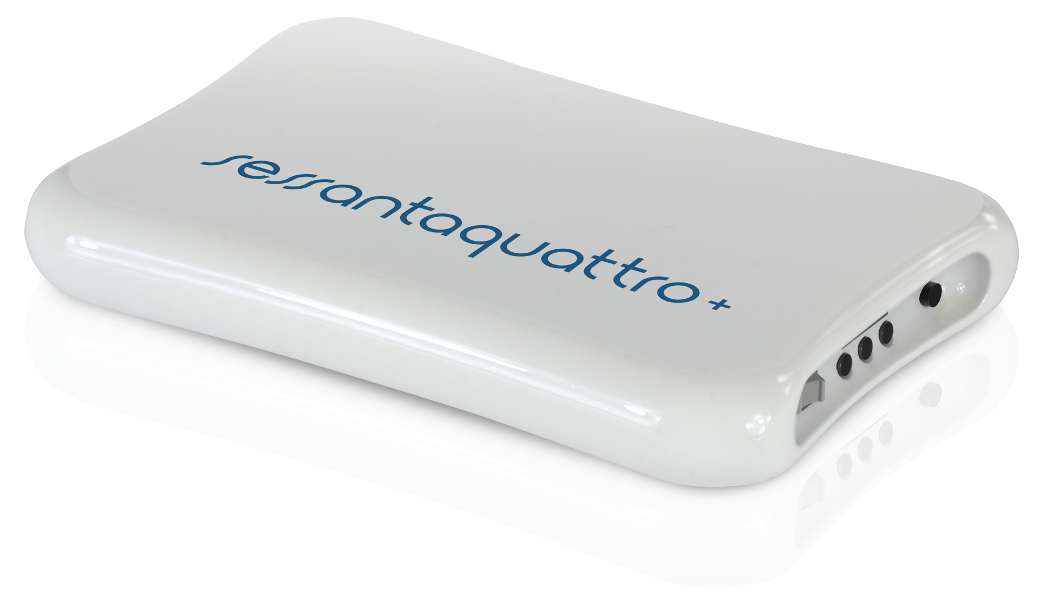
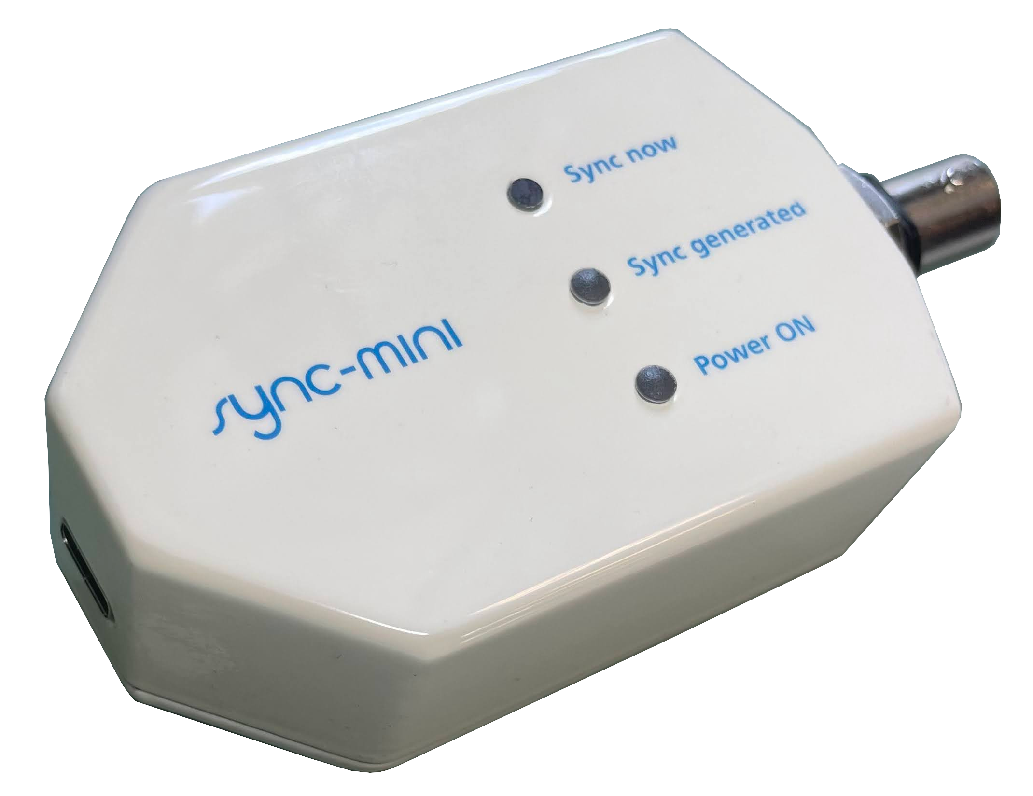
How To Use SyncMini
The pulse received by the WiFi devices sets the bit 15 (MSB) of the accessory channel 1. Offline it is possible to check this bit and use it to align different wireless devices or other acquisition systems receiving the trigger signal from the BNC. The SyncCode is available few samples later the Sync bit on the Acessory channel 1 on bits 14..8.
The switch resets the Sync generation time pattern (not the code)
V
Signal sent through RF to wireless devices and available on the Sync BNC
5V
5s
4.9s
4.8s
3.1s
3s
5s
t
LED blinks
Terminal (e.g.: TeraTerm 115200 baud)
Sent pulse with code: 20
Sent pulse with code: 21
Sent pulse with code: 22
Sent pulse with code: 23
V
5V
t
VirtualCOM port
1 ms

